Slide 1
Navigating ResearchUVA Powered by Huron (PBH)
MaryBeth Spaulding
Office of Sponsored Programs

Slide 2
Today’s Agenda
Introduction and Resource Overview
Introduction to Terminology and Navigation in ResearchUVA Powered by Huron (PBH)
Navigation Demonstration

Slide 3
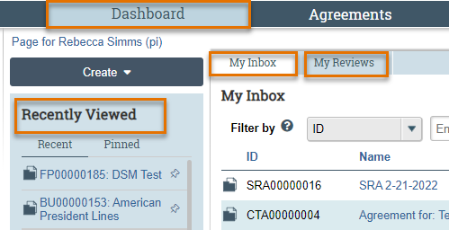
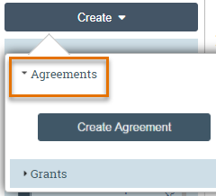
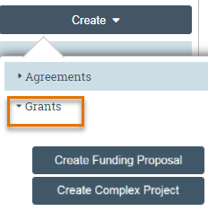
Terminology and Navigation
Navigating in ResearchUVA PBH
From your Dashboard:
My Inbox: Items that require you to take action.
My Reviews: Items assigned to you to review. These are a subset of the items in My Inbox.
Create menu and buttons: Create actions you can perform.
Recently Viewed: The last several items you viewed. Look here for an item you worked on recently.

Slide 4
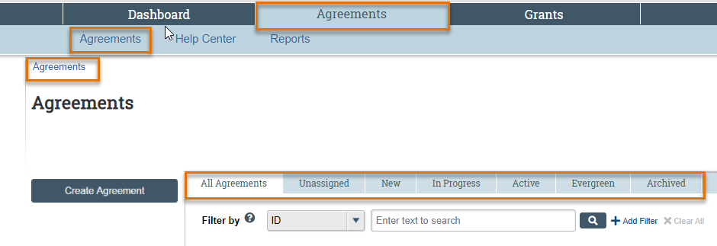
Terminology and Navigation
Navigating in ResearchUVA PBH
To find a specific Proposal, Award or Agreement, you can navigate to all of your records and then sort by one or more criterion
A “breadcrumb” trail is in the top left corner

Slide 5
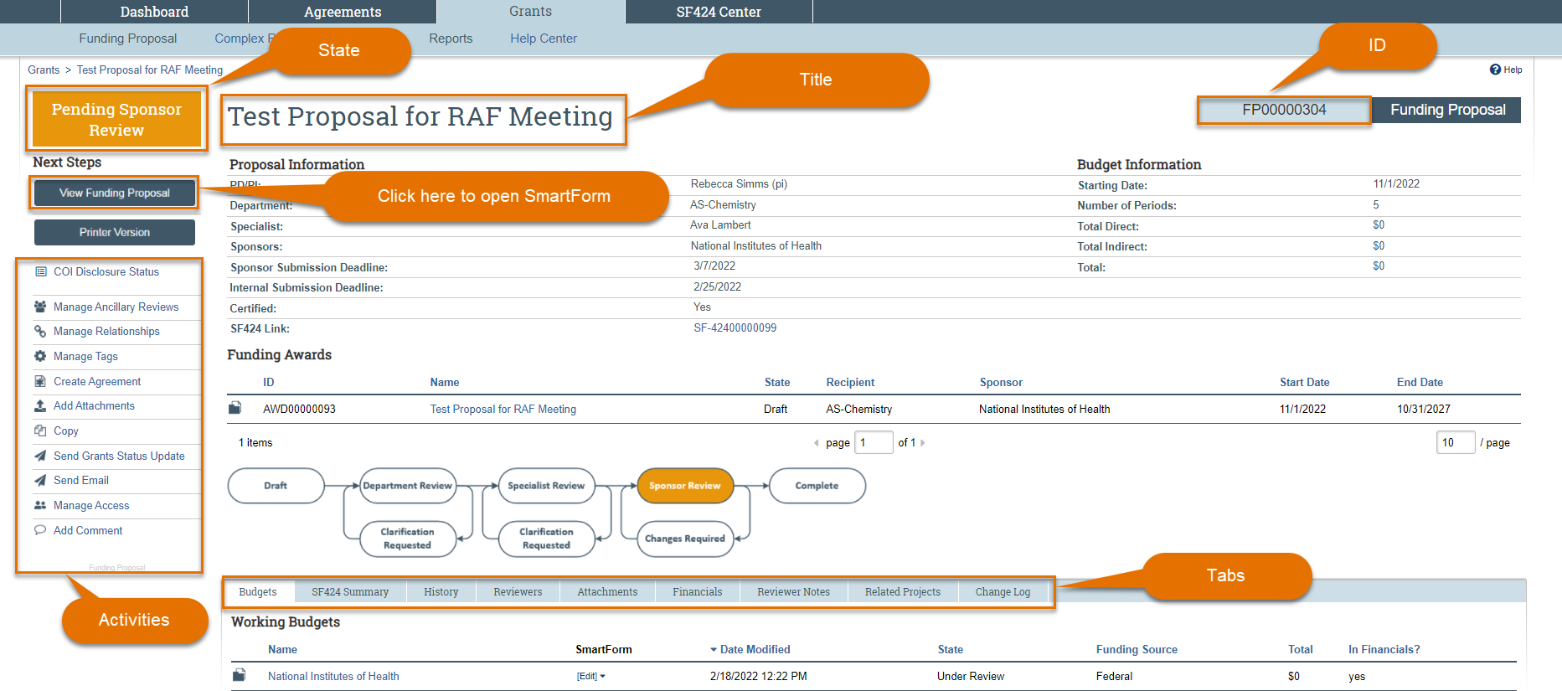
Terminology and Navigation
Workspace

Slide 6
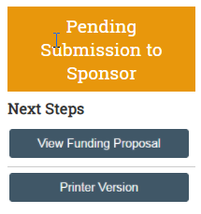
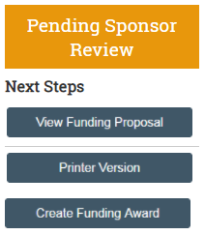
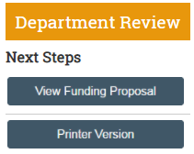
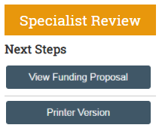
Terminology and Navigation
Accessing the SmartForm from the Workspace
Notes:
The workspace can be accessed in all stages – it will be editable or view only depending on the state and a user role + the individuals role on the project

Slide 7
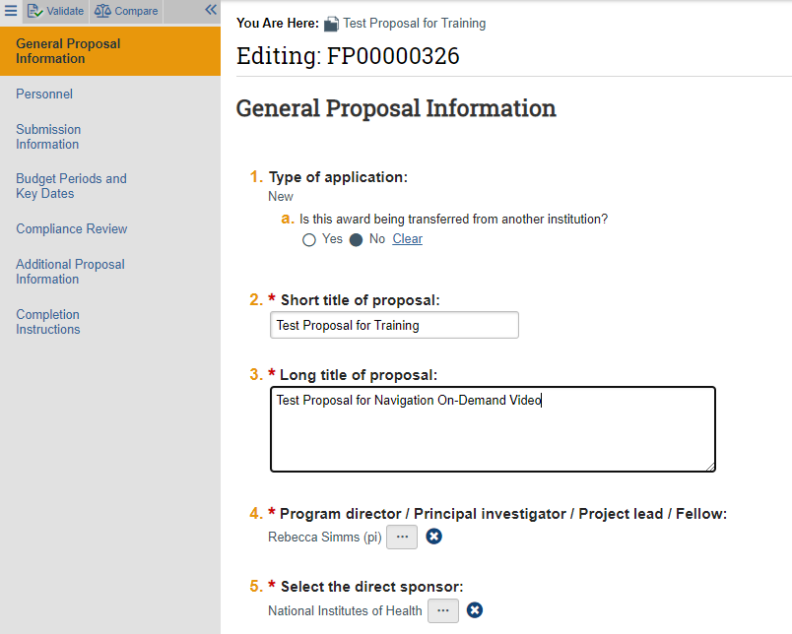
Terminology and Navigation
SmartForm
The SmartForm contains a list of all the pages or forms in the left navigator.
SmartForm fields are editable when you have clicked “Edit” or will show the previously entered data when you have clicked “View”

Slide 8
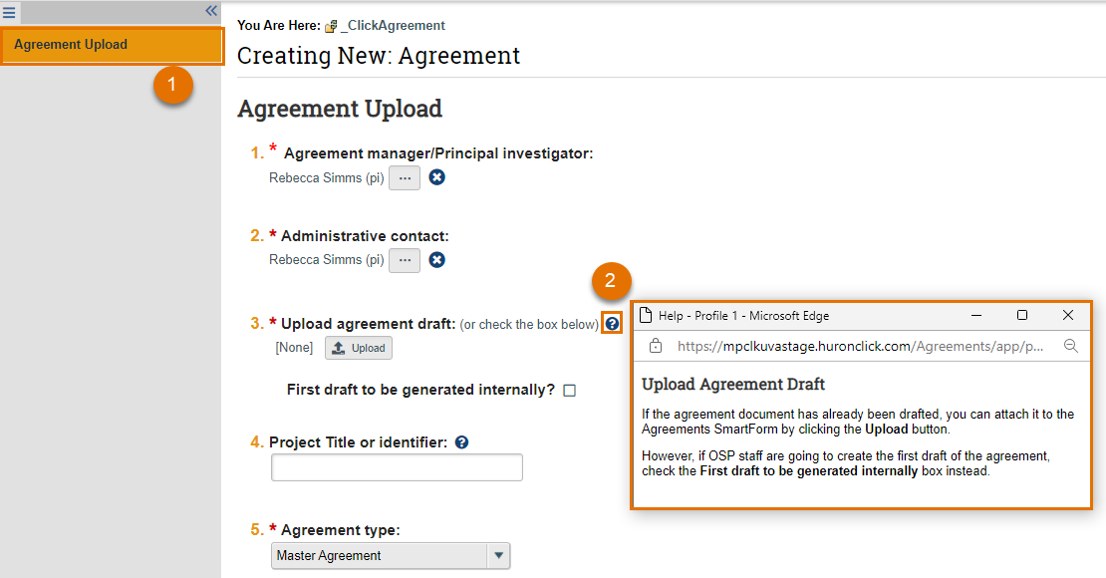
Terminology and Navigation
Using the SmartForm
1. The remaining SmartForm pages will fill in after you complete and save the General Information page
2. Clicking on the help text icon (question mark) will bring up a help text pop-up window containing UVA instructions for that question

Slide 9
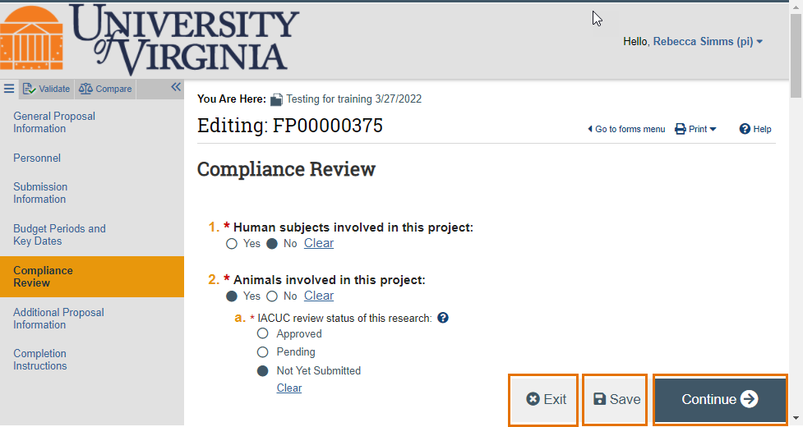
Terminology and Navigation
Using the SmartForm
SmartForm pages will have 3 “buttons” at the bottom: Exit, Save and Continue (Continue is replaced with Finish on the final form)
Exit returns to the Workspace
Save saves the page
Continue saves the page & moves to next page
Finish saves & returns to the Workspace

Slide 10
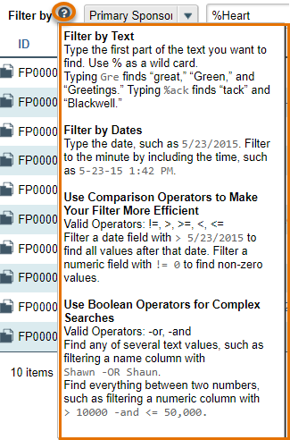
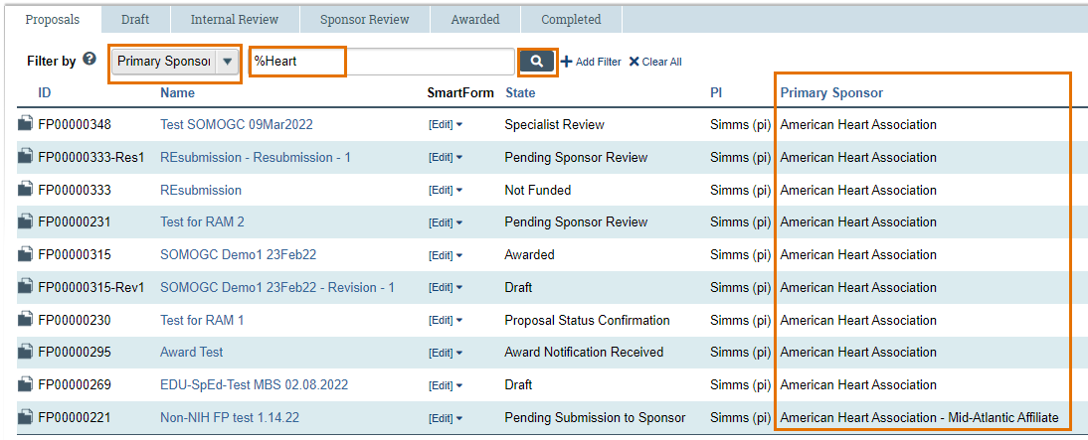
Terminology and Navigation
Using the Search Feature to Filter Data
This screenshot features a “wildcard” search for the word “heart” to find proposals to the American Heart Association
To complete this search, select “Primary Sponsor” in the search drop-down, type “%heart” and then click the search icon to complete the search
This screenshot provides an overview of the available search filters. You can always find these options by clicking the help text icon (question mark)

Slide 11
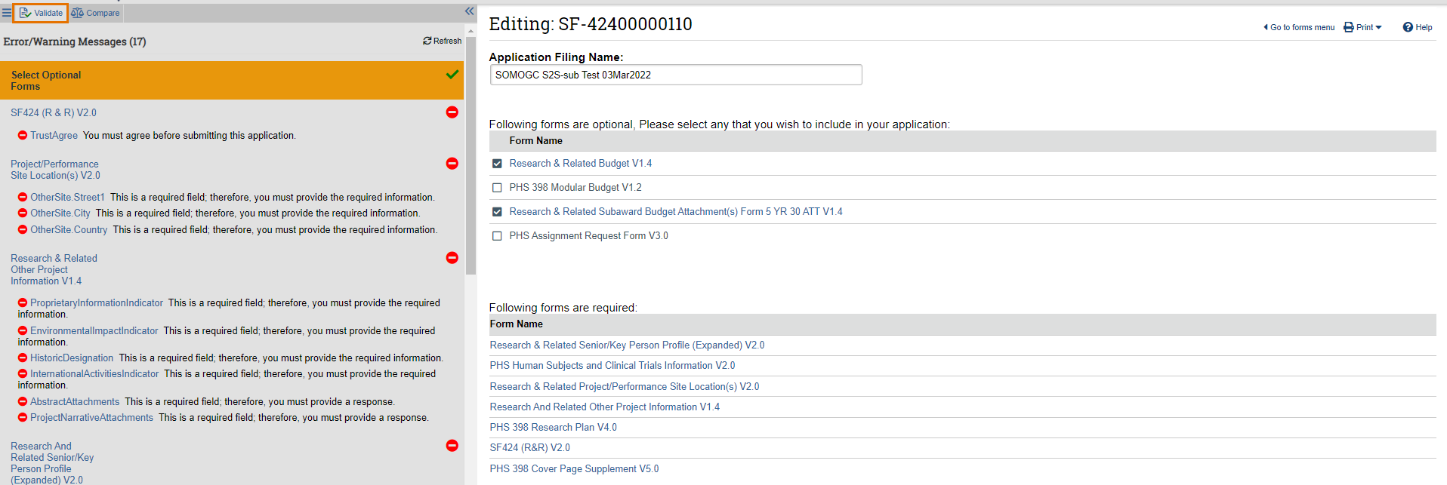
Terminology and Navigation
SmartForm Validation
Clicking the "Validate" button will show all the errors or warnings that should be addressed before submitting a project
This screen shot is a SF424 but validate is available on all SmartForms and works the same way. In the case of a SF424 validation, the form validates against Grants.gov requirements

Slide 12
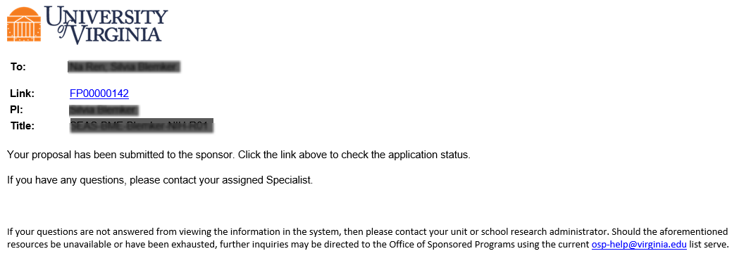
Notifications
System Notifications
System notifications are short email messages sent by the system to alert a users an action in the system – notifications often ask the user to take an action to move a project forward in workflow
Notifications contain a link that will take users to the project that requires their action or attention. Users can also navigate directly to a project using the Dashboard or Grants/Agreements module pages

Slide 13
Naming Conventions
Notes:
Placeholder slide

Slide 14
Terminology and Navigation
Demonstration
Notes:
The workspace can be accessed in all stages – it will be editable or view only depending on the state and a user role + the individuals role on the project

Slide 15
Thank you
https://research.virginia.edu/osp

