Slide 1
ResearchUVA Powered by Huron (PBH)
Training Series
Create and Submit a Proposal: Grants.gov Proposals and the SF-424
(Part 3)

Slide 2
Agenda
Welcome and Training Tips
Resources and Support
Grants.gov Proposal Overview
Grants.gov Proposal Demonstration
Hands-On Exercise
Wrap-Up
Notes:
Hands-on exercise – if you do not have a proposal you can copy, let us know in the chat so we can work to create a proposal for your hands-on exercise.

Slide 3
Instructor Introduction and Welcome
Instructor Name
Instructor Unit
Instructor’s favorite Grants.gov feature

Slide 4
Training Tips
Mute / Unmute
Video
Questions
Breakout rooms for live exercise
Notes:
Video not required
Questions in chat

Slide 5
Resources and Support
ResearchUVA PBH Website:
https://research.virginia.edu/osp
Support Materials
Reference guides, job aids, checklists, videos
Instructor-led Training Sessions
Zoom (virtual) Office Hours
M-F during business hours April 25th – May 6th
Office hours continue the week of May 9th, schedule will be posted on website
Submitting school representatives will attend office hours
Helpdesk Support
ruva-huron-help@virginia.edu
Notes:
A version of this training session will be recorded and posted to the website by go-live (April 25th)
Immediate feedback for something you are working on in office hours (bring live cases we can help you with)
Helpdesk will provide support for technical issues

Slide 6
What is Changing? What is Staying the Same?
What is Changing?
Many Federal Grants.gov submissions will be submitted with ResearchUVA PBH as a system-to-system (S2S) submission
The Funding Proposal, Budget, and SF424 will all be created and reviewed in the system
What is Staying the Same?
Multi-component (complex) proposals will be submitted via Workspace and/or ASSIST (for NIH)
Support from OSP and Submitting School Pre-Award Offices
Notes:
NEH, DOD, etc. could also be submitted in workspace – will be a case-by-case submission.

Slide 7
Session Objectives
Create and Update the SF424
Understand Funding Proposal, Budget, and SF424 Relationships

Slide 8
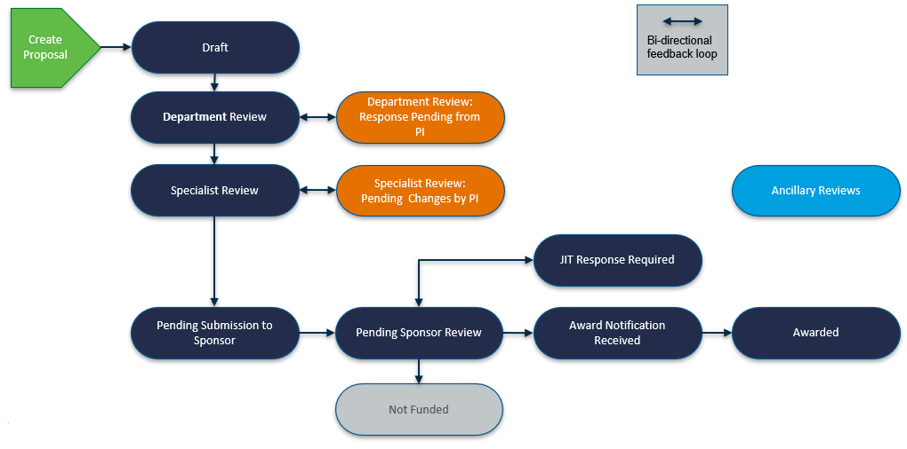
Funding Proposal Workflow
Notes:
The FP, budget and SF424 are the three components of the overall SF424 submission.

Slide 9
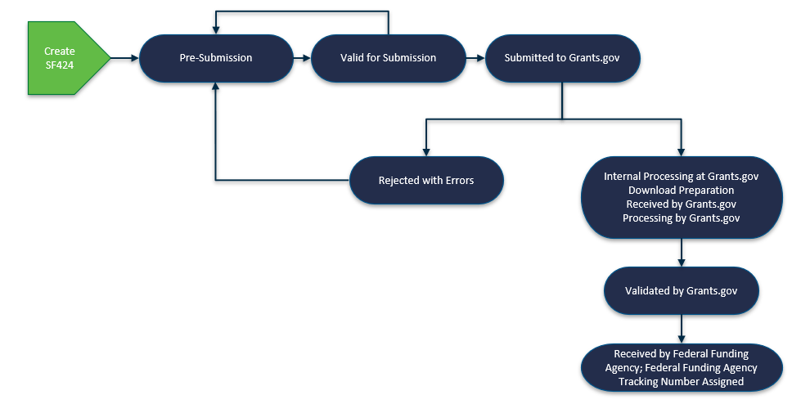
SF424 Workflow
Notes:
The FP, budget and SF424 are the three components of the overall SF424 submission.

Slide 10
Putting it all Together
Enter info in FP
Enter info in Budget
SF424 contains the FP, budget, and sub budget info
Click on
“Create-Update SF424” activity + select optional forms you want to include
Notes:
Explain the relationship between FP, budget & SF424. How do these components come together for a successful Grants.gov submission? What is the sequence to complete these and how does the data flow?
Create FP
Create budget(s) – reference sub budget in talking points
Create SF424 last to allow FP & budget data to flow to SF424
The next slide outlines information entered in each component

Slide 11
Putting it all Together
FP
Title
Biosketches uploaded here
Budget
“Include in consolidated budget” = yes
Subaward SF424 detailed budget(s) uploaded in the subaward budget
SF424
Every field, including items that mapped from FP, budget and subaward budget, are editable
Sponsor
PI + 3a institutional personnel + 3b senior/key non-institutional personnel
Upload most attachments here, including the budget justification
Humans + animals
Answer most SF424 questions here
Notes:
Overview of “what is entered where”

Slide 12
Putting it all Together – Making Changes
Make changes in FP
Make Changes in Budget + Sub Budget
SF424 updates with those changes*
Click on
“Create-Update SF424” activity + select forms you want to update
*Note: Changes do not go in the other direction! SF424 changes do not update the FP or budget
Notes:
Talking Point – select only the forms that need updating.

Slide 13
Funding Proposal SF424 – Live Demonstration
Create a Funding Proposal
This is a review from Session 1 and will highlight how information maps from the funding proposal to the SF424
Create a Budget
This is a review from Session 2 and will highlight how information maps from the budget to the SF424.
Create and Complete the SF424
Use Validate Submission prior to submitting for review
Review a Submission with a Modular Budget
* Demonstration only. The full workflow will not be part of today’s hands-on exercise.
Notes:
We are using NIH today as an example, but the principles will carry to other sponsors.
Please note that we’re showing what the system looks like and how it is relatively similar to what we use today in Workspace and ASSIST. The intention is to also explain and how the FP, budget, and SF424 go together. Our intention is not to review the NIH application guide directions. Attendees who submit regularly to the sponsor we chose for today’s example are already familiar with the SF424 form pages.

Slide 14
Today’s Hands-on Exercise
Copy a funding proposal from the Funding Budget session
New proposal name = include today’s date, your initials, and “Grants.gov session”
20220405 MAS Grants.gov session
Open and Update the new Funding Proposal
Create and complete the SF424
Review the SF424 Workspace
Return to the Funding Proposal Workspace, review SF424 tab
School of Medicine breakout group will also validate submission
Notes:
The handout does not include detailed instructions for reviewing the workspace as that is demonstrated in-depth in the demonstration and we want to keep handouts short.

Slide 15
Thank you for joining today!
Be sure to join upcoming training sessions for Awards and Agreements.

Slide 16
Questions?
ruva-huron-help@virginia.edu

