Slide 1
ResearchUVA Powered by Huron (PBH)
Department Review
MaryBeth Spaulding
Office of Sponsored Programs

Slide 2
Today’s Agenda
Introduction
Terminology and Navigation
Department Review
Demonstration

Slide 3
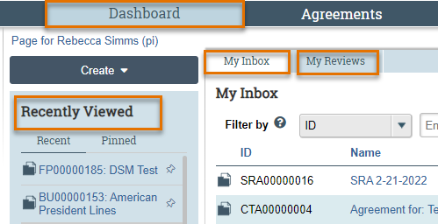
Terminology and Navigation
My Inbox: Items that require you to take action.
My Reviews: Items assigned to you to review. These are a subset of the items in My Inbox.
Recently Viewed: The last several items you viewed. Look here for an item you worked on recently.

Slide 4
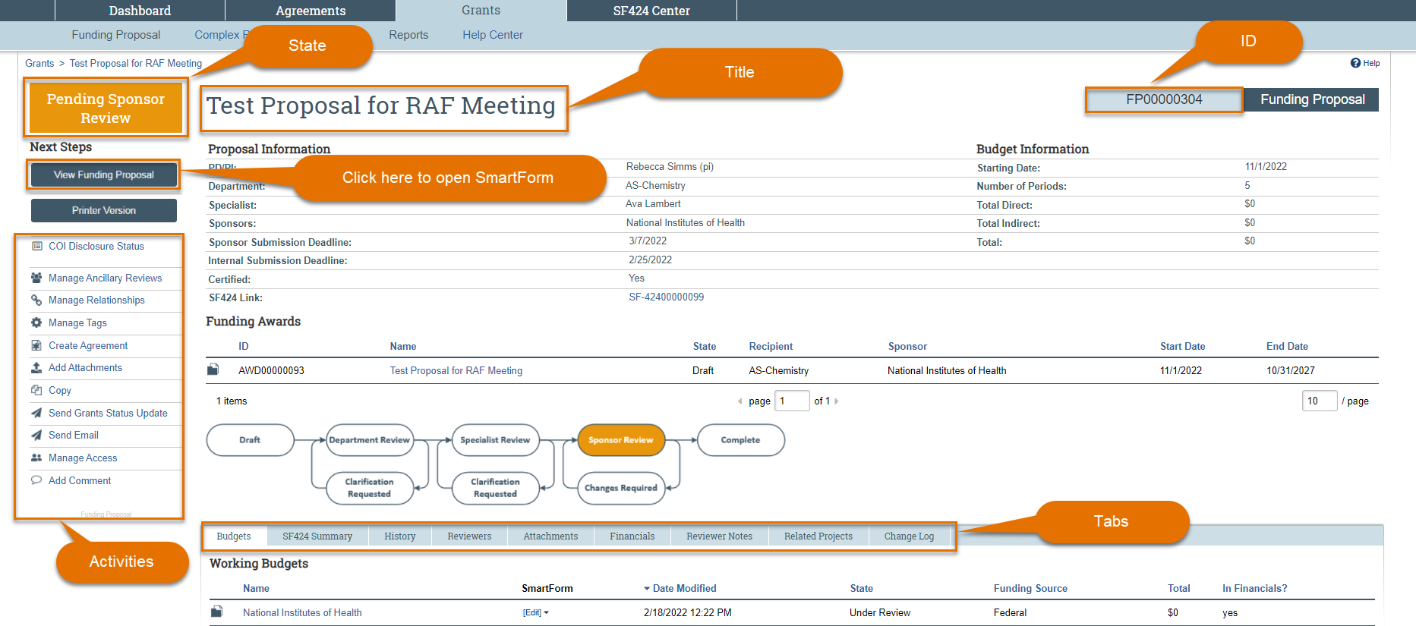
Terminology and Navigation
Workspace

Slide 5
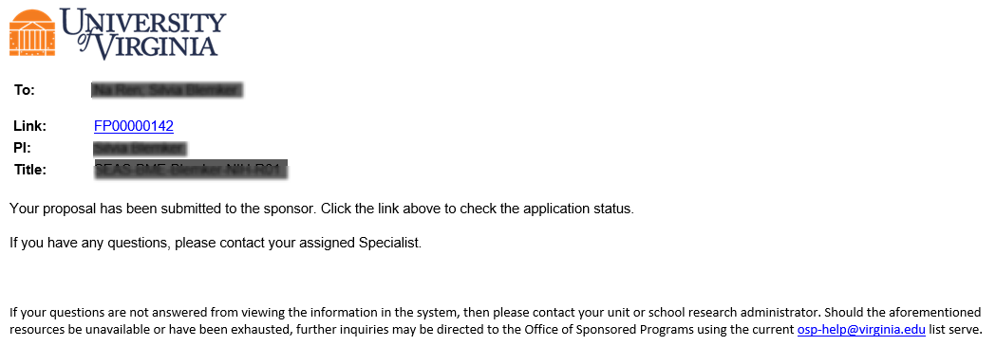
Notifications
System Notifications
System notifications are short email messages sent by the system to alert a users an action in the system – notifications often ask the user to take an action to move a project forward in workflow
Notifications contain a link that will take users to the project that requires their action or attention. Users can also navigate directly to a project using the Dashboard or Grants/Agreements module pages

Slide 6
Department Review Overview
Proposal Review Process
PI/Study Staff
Prepares & Submits
Proposal Components
Department/School Reviews & Approves Proposal*
Specialist Reviews & Approves Proposal
Proposal Submitted to Sponsor
*There will be 1-2 levels of Department Review.
Funding Proposal
Budget(s)
SF424 (if applicable)
Routed Proposal
Components
Proposal Components

Slide 7
Department Review Overview
What happens in the Department Review stage?
After the proposal draft is complete, the admin contact or PI routes the proposal to Department Review. Depending on your School, Department Review may include:
A review of the proposal components and approval by your Department Chair or their delegate
A review of the proposal components and approval by your School Dean or their delegate
If your School is a Submitting School, the School will review, approve and submit to the Sponsor as part of Specialist Review. For proposals that route to OSP for review and submission, the School will review and approve as part of the Department Review stage.

Slide 8
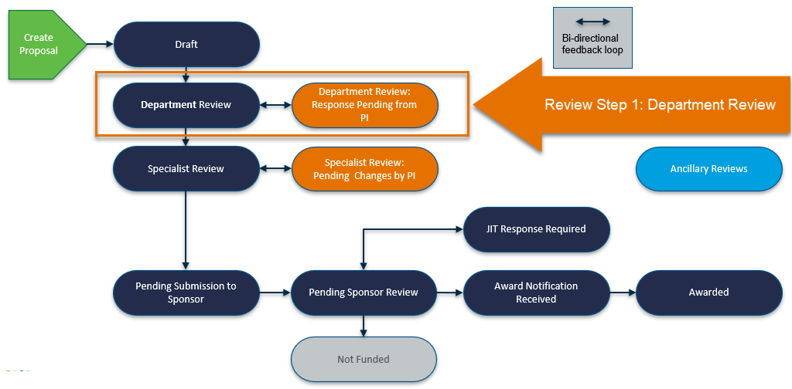
Department Review Overview

Slide 9
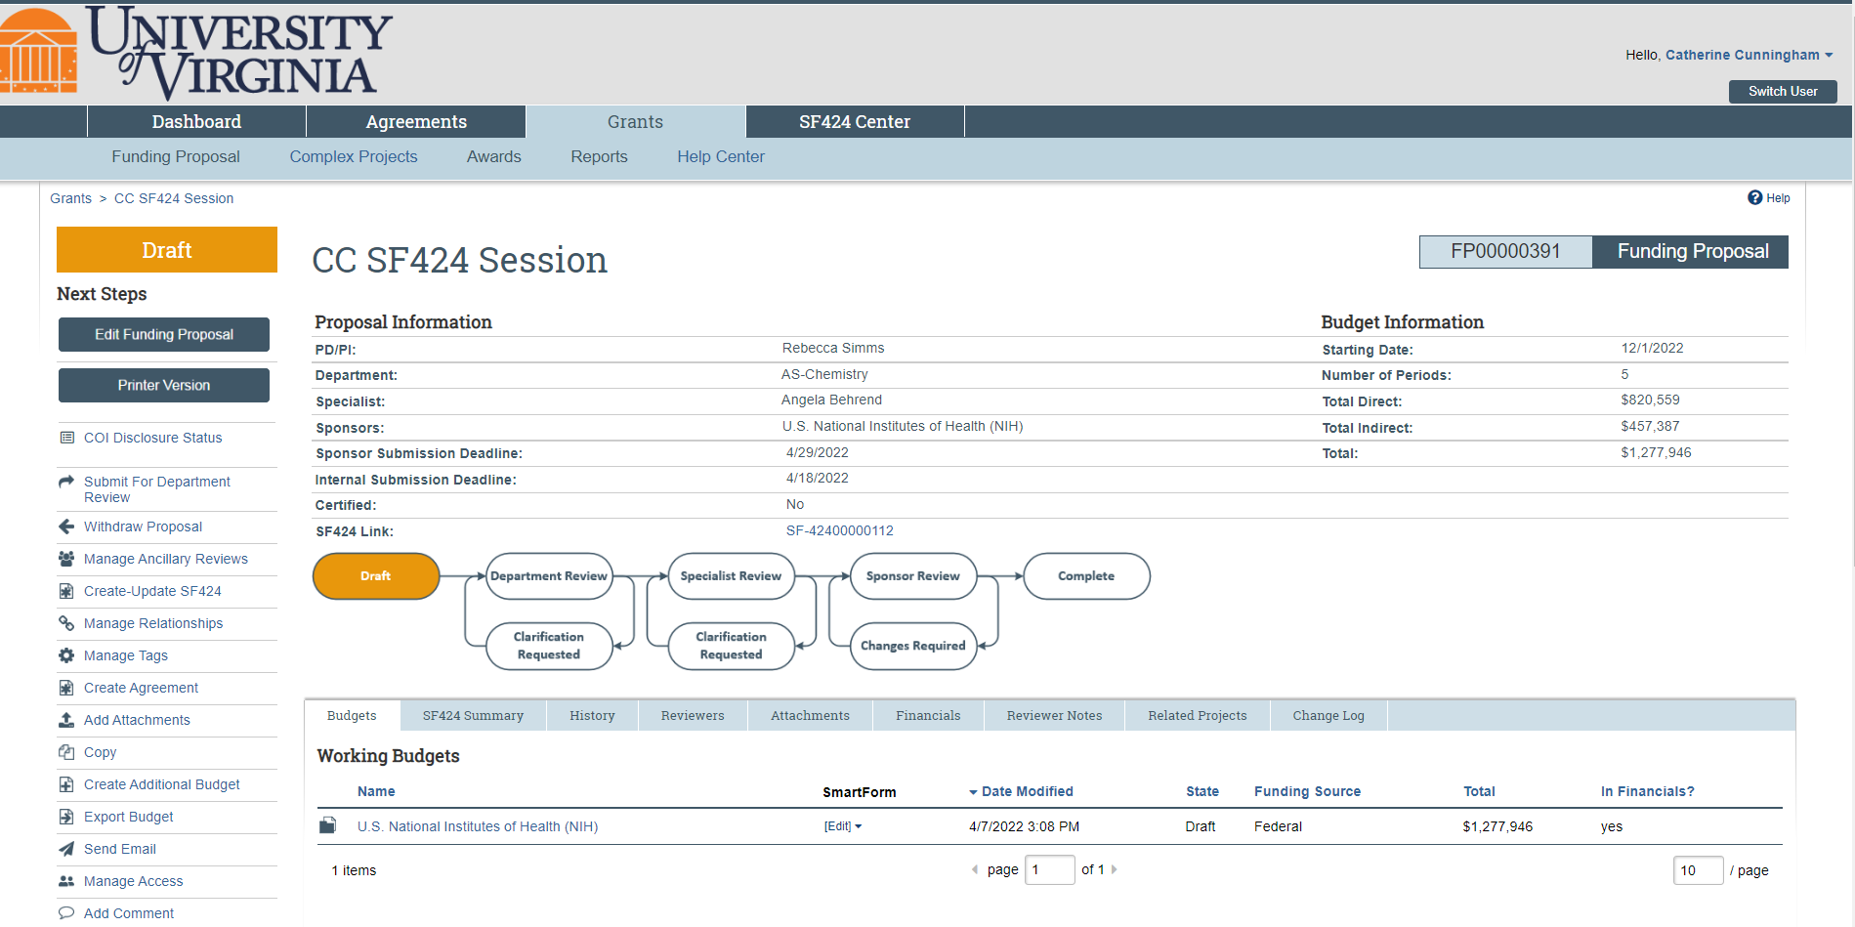
Department Review Overview
Admin contact submits for Department Review

Slide 10
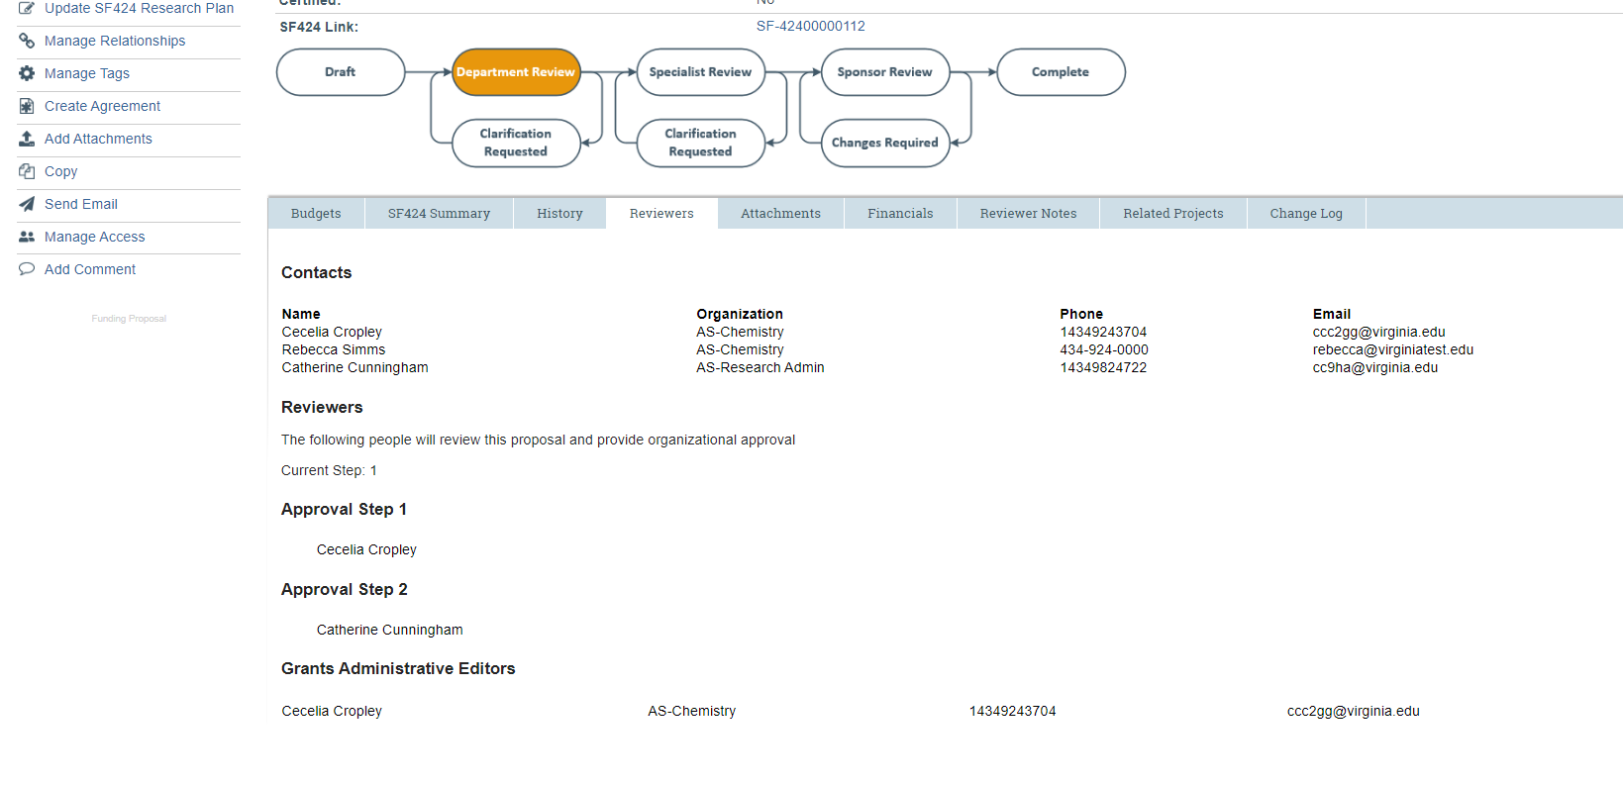
Department Review Overview

Slide 11
Department Review Overview

Slide 12
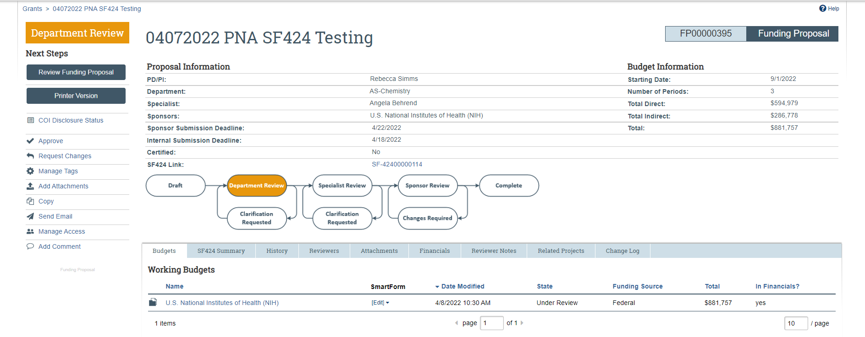
Department Review Overview
1
3
4
2

Slide 13
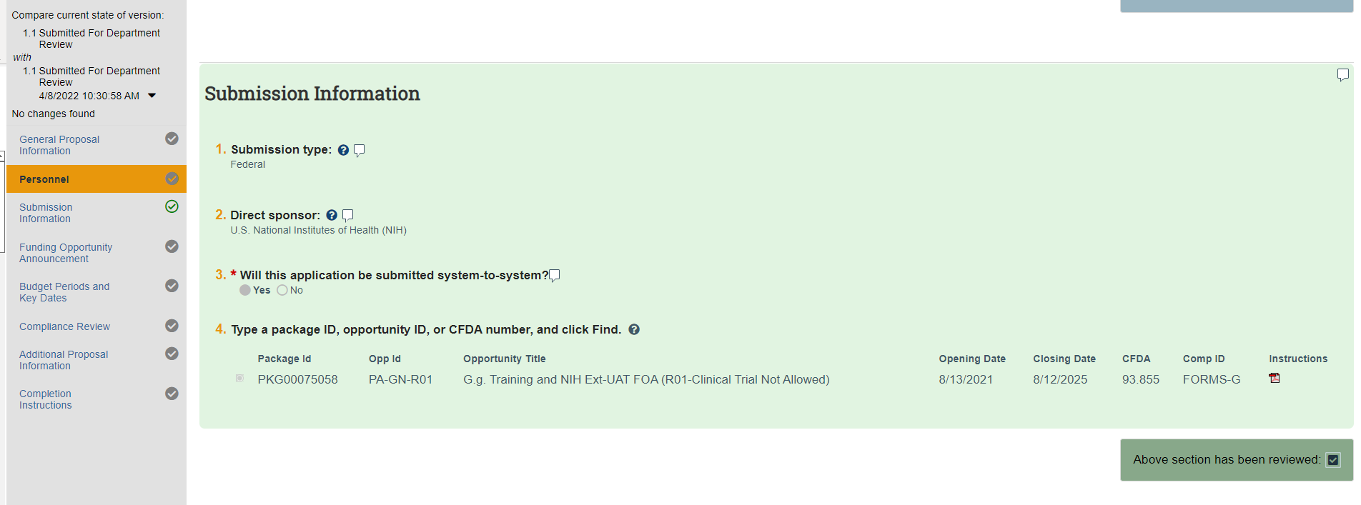
Department Review Overview

Slide 14
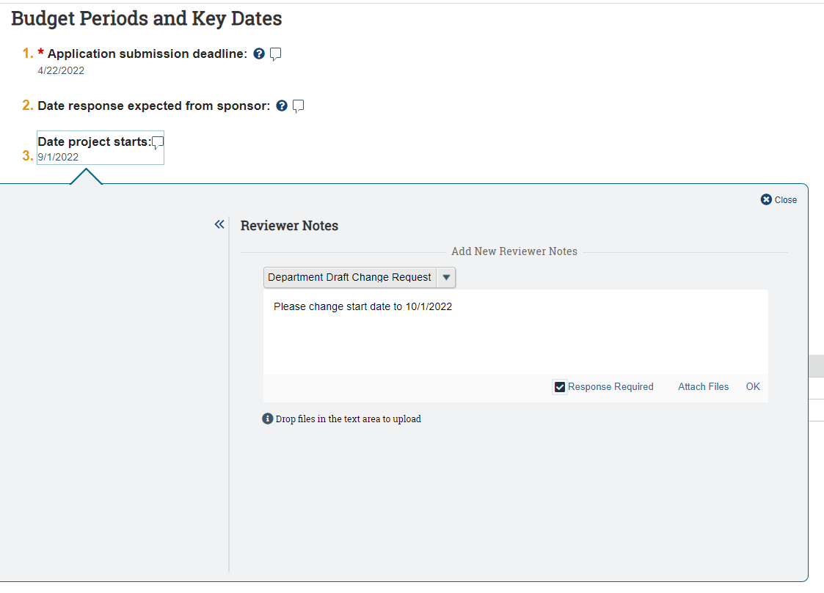
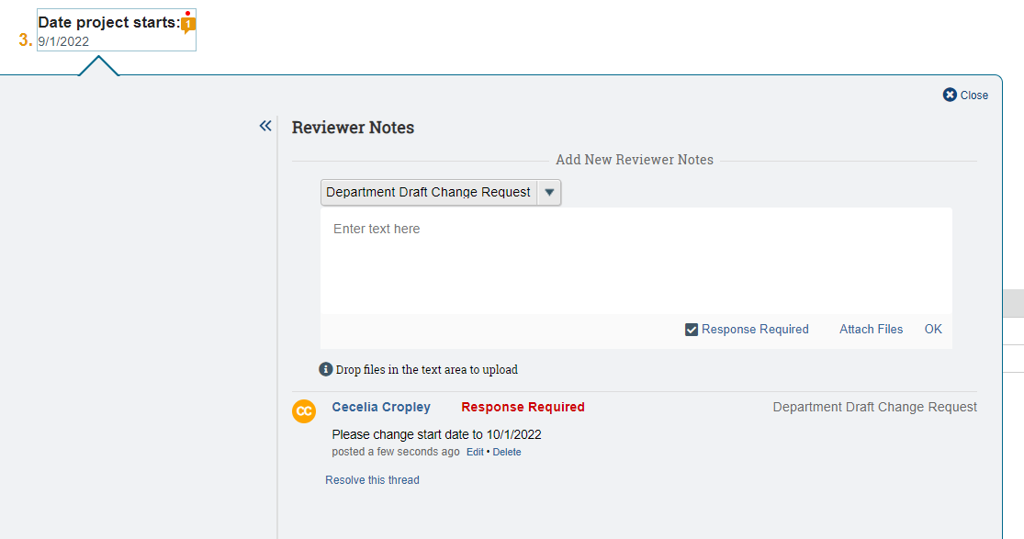
Department Review Overview

Slide 15
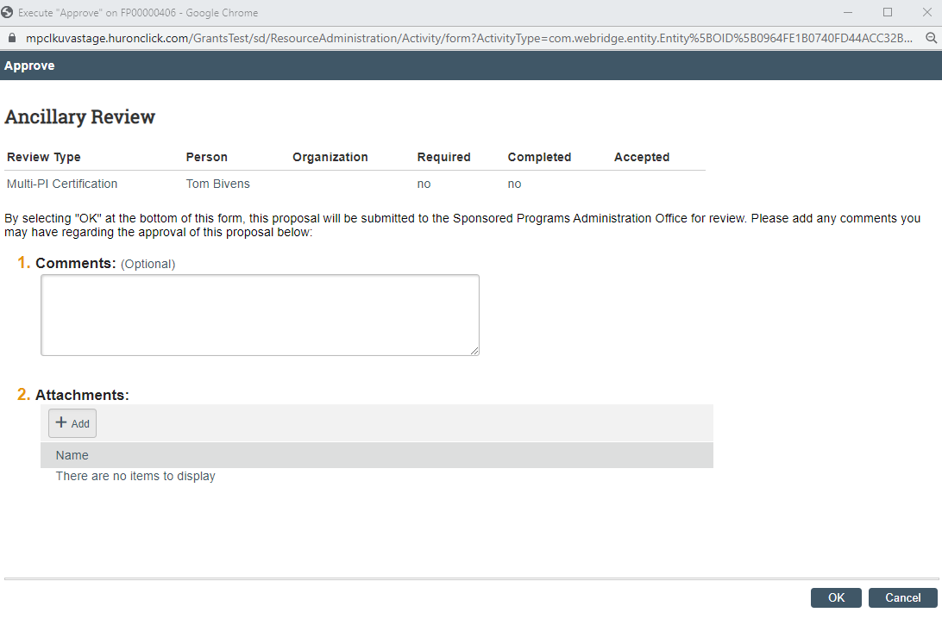
Department Review Overview

Slide 16
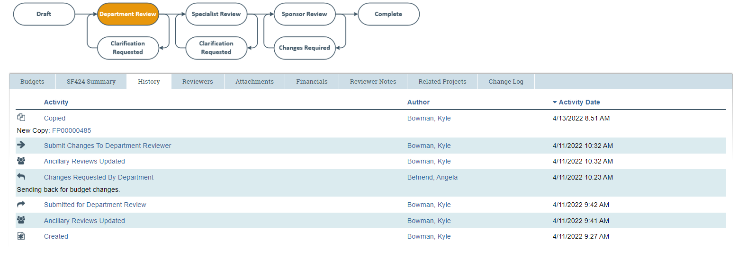
Department Review Overview

Slide 17
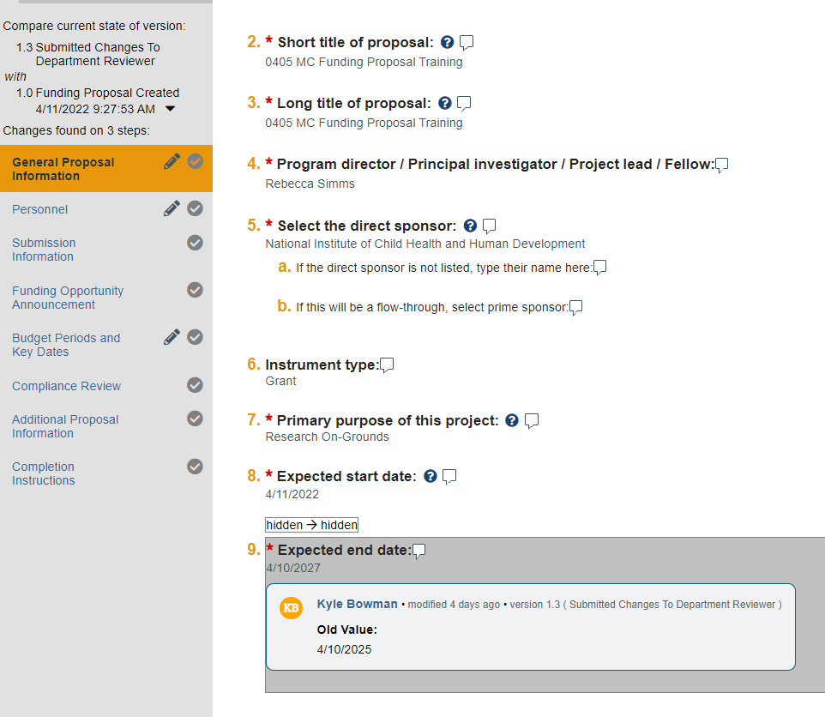
Department Review Overview

Slide 18
Demonstration

Slide 19
Questions?
ruva-huron-help@virginia.edu

