Slide 1
UVA Procedure for Managing Cost Sharing

Slide 2
Cost Sharing at Proposal Stage
Proposal Stage:
PI and Department prepares proposal based on Sponsor solicitation regarding including cost sharing in the applications.
Mandatory – required by Sponsor and must be tracked in companion account.
Voluntary Committed – not required by Sponsor but quantified in the proposal, when awarded, cost sharing becomes a binding commitment and must be tracked in a companion account.
Voluntary Uncommitted – not required by Sponsor nor quantified in the proposal; institution supported research costs, not required to track.
Department confirms how the proposed cost sharing will be covered; provides non-sponsored award information in ePRF upon proposal submission.
Along with the normal proposal review process, proposed cost sharing and associated funding sources used to support cost sharing (institutional or third party) are also reviewed and acknowledged by department senior leadership, PI, Grants and Contracts

Slide 3
Cost Sharing At The Award Stage
Award Stage:
Grants and Contracts receives Sponsor award notice and creates G&C PTAO. When cost share is required, companion account is created to track institutionally supported cost shared expenditures in the financial system
When cost sharing is covered by waived F&A and/or a third party (subawardee, consultants, other donors, etc.), a CS award is not required, but the Reference tab in the G (sponsored) award is coded with the appropriate cost sharing codes
An “Action” is logged in ResearchUVA for Post Award, with a request to review the set-up of sponsored (GXXXXX) and cost share companion awards (CSXXXXX)
Post Award contacts Department to verify and/or obtain the non-sponsored PTAO(s) funding the cost share commitment
Post Award finalizes the action in ResearchUVA to distribute the Notice of Award for the CS award to PI & Department
Post Award portfolio Accountant (Oracle role=Award Manager) enters deadlines for financial reporting in Oracle Grants module

Slide 4
Third Party In-Kind Cost Sharing
Third party in-kind cost sharing requires PI’s certification of acceptable cost shared expenses that are not from UVA’s financial system
Sources for third party in-kind contributions are:
Subrecipient cost sharing: subrecipient’s invoices and/or expenditure reports should include cost sharing
department research administrator or fiscal contact to review sub’s cost sharing and advice PI to certify or reject an invoice
deviations in subrecipient’s cost share commitment will need UVA and sponsor approval via SP30/eSPAR action
Donation of consulting services: certification of time spent, quantifying the billable hours, per hour rates and amount cost shared
Donation of supplies, equipment, OTPS: certification from the donor, itemizing quantities and associated amounts at the fair market value
Unrecovered F&A costs on sponsored expenses: requires VPR’s approval for waiving F&A and sponsor approval for using unrecovered (waived) F&A for cost sharing
Unrecovered F&A costs on cost shared expenses: requires prior approval from sponsor to be included as cost sharing

Slide 5
Cost Sharing Companion Account Structure

Slide 6
Cost Share Companion Award Characteristics
CS awards are created with the same attributes as the sponsored “G” awards with the exception of:
Award Type = Cost Share
Award Purpose Code = 1138-20 Current Funds - Unrest: Other Sources (Spn Prg NonFed Cost Share 0302)
CS awards are linked to the G&C Expenditure Project
CS award NOAs are distributed the same as the G&C award/project NOAs
PI
Fiscal Contact
CS awards will not be set-up but requires certification when but not limited to:
another G award is supporting the cost sharing
third party is cost sharing
cost sharing or matching requirements are covered by waiving or not recovering F&A costs

Slide 7
Department’s Role in Managing Cost Share Companion Awards or Certificates
Department/Administrator/Fiscal Contract:
Reviews and monitors cost sharing budget
Schedules labor on the CSXXXXX Award
Creates POs or spend directly on OTPS purchases from the CS PTAO
Reviews & approves both Sponsored and CS awards during monthly Recon@
For in-kind contributions, obtains PI’s certification either using a cost share certificate for all third party commitments and waived F&A costs, and/or certifications on subaward invoices
Ensure supporting documentation (such as timesheet, consultant rate, list of supplies or OTPS or equipment with market value, etc.) is provided to OSP Post Award with the cost share certificates

Slide 8
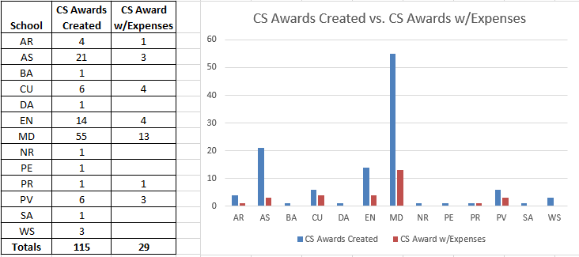
Cost Share Companion Account Information by School (June 2020)

Slide 9
OSP’s Role in Managing Cost Share Companion Awards and Cost Share Commitments
OSP Post Award
Reviews and tracks cost shared expenditures
Sends 90 day notices for termination of sponsored awards, including cost sharing requirement
Sends FSR memos requesting confirmation of final closing of sponsored and cost shared awards
Includes cost shared expenditures from the CS awards in final financial reports/invoices to sponsors
For in-kind contributions, obtains PI’s certification either using a cost share certificate or on subaward invoices
Ensures cost shared expenditures are trued up at fiscal year end
Credits CS expenditure types on CS awards
Debits CS expenditure types on non-sponsored awards

Slide 10
Mock BBA for Cost Share PTAO
PROJECT: 159160
Project from: 01-JAN-2019 to 31-DEC-2023
AWARD: CS000XX
Award Name: Expect Miracles NIH AGENCY AWARD#: R01B12345
Award from: 01-JUL-2019 to: 31-DEC-2019
Expenditure Category | Total ITD Budget | Period Budget Activity | FY Costs | Project TD Costs | Commitment | Project TD Budget Balance
OSP Only, Personnel | 0.00 | 0.00 | 456.00 | 456.00 | 0.00 | (456.00)
OSP Only, OTPS | 0.00 | 0.00 | 50,000 | 129,026.97 | 0.00 | (129,026.97)
Indirect Cost | 0.00 | 0.00 | 0.00 | 0.00 | 0.00 | 0.00
Total | 0.00 | 0.00 | 104,622.90 | 227,154.54 | 0.00 | (227,154.54)

Slide 11
Truing Up Cost Share Companion Accounts
CS awards are trued up on a quarterly basis with the exception of the quarter ending in June, batches are uploaded before the close of fiscal year-end.
Post Award requests departments to confirm and/or provide funding sources that will provide funding for cost share expenses. (Note: If multiple fund sources are used, the department will need to provide details on what expenses are to be posted to which PTAO).
Post Award moves costs via batch uploads (Trans Source Code: GMSA-OSP) from the CS awards to the cost share funding source(s) using unique CS-expenditure types truing up the CS balance to $0.
Departments utilize the same UBI reports used for managing G awards (e.g., GA BBA, GA Analysis, etc.) for tracking CS award costs.
CS Awards will include both the original expenditure types as well as the “credits” posted on the NEW CS-expenditure types.

Slide 12
NEW Cost Share Expenditure Types
New Expenditure Types
Cost Share-Faculty Salary
Cost Share-Faculty FB
Cost Share-Univ Staff
Cost Share-Univ Staff FB
Cost Share-Classified Salary
Cost Share-Classified FB
Cost Share-Wages
Cost Share-Wages FB
Cost Share-Contractual Svcs
Cost Share-Supplies&Materials

Slide 13
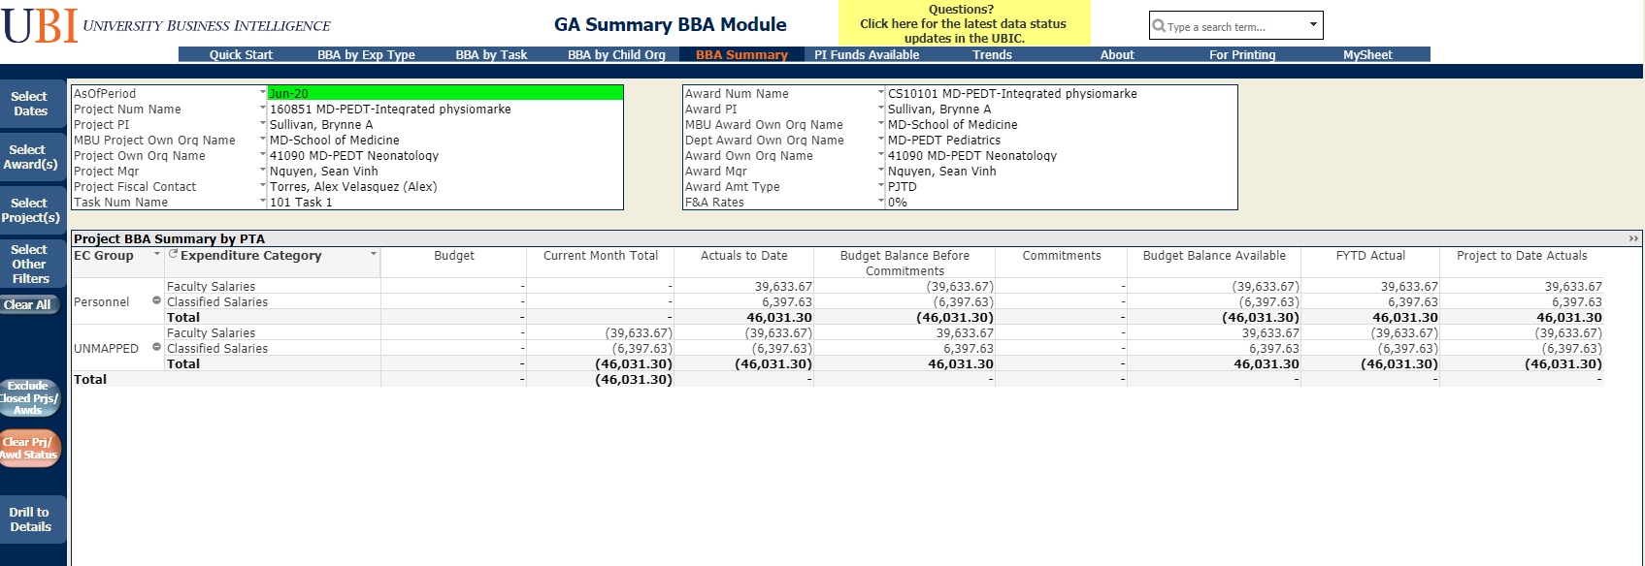
BBA Summary Report for An Actual CS Award

Slide 14
BBA by Exp Type Detail Report for CS Award

Slide 15
Recon@ Reports for G&C and CS PTAO

