Slide 1
Costing Basics: An Introduction to the Concepts
Office of Sponsored Programs
Notes:
Welcome – our desire is to have an interactive session with questions and sharing of information and experiences with Cost Accounting Standards
Sign-In
Handouts
Few housekeeping notes
Next slide – Introductions
Pre-Session Activity (sets the stage for general knowledge or misunderstandings that will need to addressed during the session)

Slide 2
Pre-Session Discussion and Our Learning Objectives
Costing Basics
When you hear ‘Costing’…what do you think of?
What makes a cost ‘allowable’ to a sponsored project?
What makes that same allowable cost – ‘allocable’ to a sponsored project?
What is the name of the costing circular for Educational Institutions on which we base our costing practices and decisions?
Give some examples of Direct costs.
Give some examples of Facilities & Administrative (F&A)/Indirect costs
Notes:
THIS SLIDE WILL BE HIDDEN
Ask the class. They do not need to respond but they need to keep these questions in mind and also consider their depth of knowledge.

Slide 3
Pre-Session Discussion and Our Learning Objectives
Costing Basics
What makes Direct and F&A cost different?
Do you know how the institution arrives at the F&A rates?
Are you familiar with Transaction Controls and how they are managed?
What is Cost Share?
What do you consider in selecting an Expenditure Type to charge?
Can you converse comfortably with your faculty/staff on costing matters?
Notes:
THIS SLIDE WILL BE HIDDEN
Ask the class. They do not need to respond but they need to keep these questions in mind and also consider their depth of knowledge.

Slide 4
Costing Basics
Federal Costing Requirements:
Don’t charge the Government twice for the same cost.
(Direct Costs versus Facilities & Administrative Costs)
F&A Costs = The Cost of Doing Business
Don’t charge the government for any expressly ‘unallowable’ costs.
Be CONSISTENT in the budgeting, charging and reporting of costs on Federally sponsored awards-this consistency must be achieved across grounds
Notes:
Start out with a small taste of history about CAS…what went wrong?
CAS simply says………
The bulk of audit findings are noted with these 2 points. Universities have charged items both directly to the Sponsor and then recovered that same cost through F&A recovery (this can get tricky even if F&A is not recovered at the full negotiated rates and the award is accepted by UVa) AND more rarely UNALLOWABLE costs (either defined by A-21 or the Sponsor’s specific terms and conditions) have been charged.
KEY POINT: What we all need to work toward is not charging unallowable costs and having documented CAS Exception materials on hand when the question of double billing for the same costs arise. There are some cost types are that particularity troublesome and we will cover those soon.
Through training like this and other courses to be offered……judgment skills should be sharpened so that the pure black and white errors in cost application to awards is reduced to judgment calls and documentation to support our decisions!!!

Slide 5
CAS: Four Standards CURRENTLY Applicable to Educational Institutions Receiving $50M or More in Federal Awards
Costing Basics
Standard #501 (48 CFR 9905.501):
Requires consistency in estimating, accumulating and reporting costs by educational institutions
Standard #502 (48 CFR 9905.502):
Requires consistency in allocating costs incurred for the same purpose by educational institutions (either as direct or as F&A costs)
Standard #505 (48 CFR 9905.505):
Requires accounting for unallowable costs
Standard #506 (48 CFR 9905.506):
Defines the Cost Accounting Period
Notes:
Standard 501 – requires consistent cost application from submission of the proposal through closeout and reporting of costs. Technical violations to the CAS and to our internal practices and the DS-2 can be noted in proposals contain costs that without proper justification and purpose are truly F&A costs….even if we don’t charge them that way.
Standard #502 – Requires consistency in the application of costs when charging to CAS covered projects as EITHER a direct or an F&A cost – in LIKE circumstances. Does allow for UNLIKE circumstances when considering the direct charging of ‘clerical administrative’ salaries/wages.
Standard 505 – requires that strictly UNALLOWABLE costs be removed from all direct cost billings. Dave Boling’s Cost Analysis group has processes to look for these costs but only during the preparation of the F&A cost proposal. Departments/Units are responsible for catching this first!
Standard 506 – Defines our fiscal accounting period as 7/1/XX – 6/30/XX

Slide 6
Applying Costing Requirements at UVa.
Costing Basics
APPLIES TO ANY SPONSORED AWARD SATISFYING ANY 1 OF THE FOLLOWING CRITERIA:
Federally funded
Federal Flow -through Funding
Proposal or award terms/conditions reference 2CFR200
Funds used as cost sharing
Notes:
KEY POINT: ONLY 1 criteria has to be met for the award/costs to be subject to CAS regulations/practices!
covered project - (Only the individual cost(s) being used as cost sharing would be subject to CAS Example: Clerical/Admin. travel costs claimed as cost share to an NIH project
Federal awards – have them give examples of these Sponsors including Federal Sponsors
Federal flow-Through awards – more examples (can include Industry, Foundations, State, Other Universities)
Terms and Conditions – include reference to A-21 or CAS
Funds/costs used as Cost Sharing toward a CAS subject award – give examples here (office supplies charged on a non-CAS covered award; clerical/administrative salaries or travel related to these personnel; memberships/subscriptions paid from non-CAS funding; etc.)
So what happens with the remaining % of awards that are not subject to CAS? THE ALTERNATE COSTING POLICY at UVa.:
Costs applied to these awards are still subject to the terms and conditions of the sponsor, University and State procurement practices. Some of these awards while not subject to Federal and CAS guidance still have audit clauses present or financial reporting requirements and can be reviewed for unallowable costs in the eyes of the sponsor. It is true that there is more flexibility with these funds but an audit still could occur. Be diligent in the application of costs. Awards noted by OSP as having residual funds also provide more flexibility in the application of costs, especially once any financial reporting has been performed to the Sponsor by OSP accountants.

Slide 7
WHEN do I need a COSTING EXCEPTION form?
approval is needed if criteria in the previous slide Are met, and the item being charged:
.. is normally considered part of F&A (overhead)
-and/or-
.. falls under an expenditure type that is “locked” by Transaction Controls
-and/or-
.. is NOT Transaction-Controlled, but still needs approval:
General Use Software
General/Administrative Salaries

Slide 8
Costing Basics
Is The Funding Federal/Flow-Through?
Award documentation contains the name of the Sponsoring entity (Take care here….Words like national or American don’t always denote a federal funding agency)
Award documentation references a (Catalog of Federal Domestic Assistance (CFDA) number. A number assigned to Federal programs signifying the Sponsoring agency and the program being funded.
Contracts received as direct Federal awards or via Flow-Through funding
Award documentation references 2 CFR 200
Notes:
8
CAS deals with awards of federal funds. How do we know if the award funds in the award are
The Award Purpose code indicates that the award is federal
NOTE: The award purpose code is currently NOT on the OSP’s Notice of Award (NOA)
Look at the information on the NOA: Sponsor, or Award Type, or Fund/Source Award on the NOA form indicates federal funding
The award announcement references a Catalog of Federal Domestic Assistance (CFDA) number. A CFDA number is assigned to Federal programs available to State and local governments of the United States; domestic public, quasi-public, and private profit and nonprofit organizations and institutions; specialized groups; and individuals.
See “Cost Accounting Standards” or OMB Circular-21 mentioned anywhere in the announcement

Slide 9


UVA Costing and Costing Specific Documents
Costing Basics
  POLICIES
  VIII.C.1 Compliance with Sponsor Requirements
  PROCEDURE
  OSP - Budgeting Direct Costs of Sponsored Programs
Notes:
9
This is a fairly comprehensive document that we recommend that you keep close at hand. As the document is updated given any changes in guidance, you will note a revision date to help keep us current. Access our website and this document when working through costing issues and remember to contact your Departmental or School research office and then OSP for assistance if needed.

Slide 10


The University’s Disclosure Statement (DS-2)
Costing Basics
CAS requires that the institution
Disclose...
..our “costing practices” formally in the Disclosure Statement or “DS-2” document
&
Follow...
..the practices that we have disclosed in the DS-2!
Notes:
10
The CAS Disclosure Statement or DS-2 is required to be completed for all educational entities receiving $25 million or more in Federal sponsored research dollars.
Receipt of the first dollar of Federal funding subjects recipients to the circulars and other regulatory documents and guidance…for example A-21 (which includes the CAS standards).
KEY POINT: No 2 disclosures are the same! This can lead to our research Faculty questioning our costing practices when they work/speak with collaborators operating under different guidance. The bottom line is that A-21 (the costing circular) provides the guidance necessary for institutions to make judgments and establish practices based upon these regulations and then assess HOW MUCH RISK the institution is willing to accept in not adequately applying this guidance.
OSP is responsible for the accuracy and submission of this large document. The UVa CAS Guidelines are a product of this disclosure.
DS-2 has been approved (1/06).

Slide 11

CAS: The University’s Disclosure Statement (DS-2)
Costing Basics
The DS-2 describes to the government how
we’re treating costs at the University:
  ..detailing which costs we treat (“allocate”, “assign” or “charge”) as direct costs
  …which ones we treat as facilities & administrative
  (F&A) costs.
No two disclosure statements are alike!
Notes:
11
The CAS Disclosure Statement or DS-2 is required to be completed for all educational entities receiving $25 million or more in Federal sponsored research dollars.
Receipt of the first dollar of Federal funding subjects recipients to the circulars and other regulatory documents and guidance…for example A-21 (which includes the CAS standards).
KEY POINT: No 2 disclosures are the same! This can lead to our research Faculty questioning our costing practices when they work/speak with collaborators operating under different guidance. The bottom line is that A-21 (the costing circular) provides the guidance necessary for institutions to make judgments and establish practices based upon these regulations and then assess HOW MUCH RISK the institution is willing to accept in not adequately applying this guidance.
OSP is responsible for the accuracy and submission of this large document. The UVa CAS Guidelines are a product of this disclosure.
DS-2 has been approved (1/06).

Slide 12

Talking the Same Language – Key Terms and Concepts
Costing Basics
Notes:
12

Slide 13
Costing Basics
Allowable Costs
There are 2 ways to budget, charge, and report “allowable” costs:
Direct Costs
Facilities and Administrative (F&A) Costs
Notes:
13
The difference between these 2 allowable cost categories is how the costs are presented in budgets and how we actually recover the costs to the University.
F&A costs are included in the rates that we then use to request recovery from our Sponsors. For F&A costs to be charged as direct costs, an ‘unlike circumstance’ would need to be present and be formally justified/documented. More coming on the ‘unlike circumstance’ topic.
Similar terminology = indirect costs; overhead

Slide 14

Costing Basics
Definition: Direct Costs
budgeted/charged to specific direct cost categories
allocable and identifiable to a single project
reasonably supports the technical goals/objectives/outcomes of the project
identification is made with relative ease and a high degree of accuracy
examples include: PI and research assistant salary, travel, equipment, subcontractors, lab supplies, etc.
Notes:
14
KEY WORDS in making your future judgments: specifically identifiable with the technical goals at hand, determined with relative ease and high degree of accuracy.
REMEMBER to mention the POINT OF ALLOCATION theory again…..cost/benefit relationship.
Have the audience give you some examples of DIRECT costs seen on sponsored awards.
The F&A costs cannot be tied specifically to one award and benefit many different objectives at the same time.
Ask for examples from the audience.

Slide 15

Costing Basics
Definition: F&A Costs
budgeted/charged to F&A cost category
benefit common objectives
cannot be allocated to a single project with relative ease and a high degree of accuracy
included in the University’s F&A cost rate proposal and negotiation
examples include: utilities, building maintenance, landscaping, payroll, procurement and other central office salaries, the Sticky 6, etc.
Notes:
15
The difference between these 2 allowable cost categories is how the costs are presented in budgets and how we actually recover the costs to the University.
F&A costs are included in the rates that we then use to request recovery from our Sponsors. For F&A costs to be charged as direct costs, an ‘unlike circumstance’ would need to be present and be formally justified/documented. More coming on the ‘unlike circumstance’ topic.
Have the audience give you some examples of F&A costs awards.
The F&A costs cannot be tied specifically to one award and benefit many different objectives at the same time.

Slide 16
To be considered DIRECT the cost must be:
Costing Basics
Allowable - A cost must be allowable under both the provisions of 2 CFR 200. Subpart E (Uniform Guidance), AND the terms of the particular award. (2CFR 200.403)
Allocable - The project which pays the expense must directly benefit from it. [The item charged to a grant must be directly related to the objectives of the science.] (2CFR 200.405)
Reasonable - An expense must be reasonable, in that a “prudent person” would have paid the stated amount for the good/service and also would have budget/charged the cost to a sponsored award in the same manner (2CFR 200.404).
Consistent - All costs incurred for the same purpose, in like circumstances, are either to be treated as direct OR F&A (indirect) costs (2CFR 200.412).
AARC
Notes:
16
Good Idea when deciding on the application of costs directly to an award: The prudent person test – Would your Mother approve of your doing this? Would Judge Judy be OK with your decision?
Place yourself on a jury or be the judge – Can you argue for your decision or in applying the guidance given would you have a hard time with your decision?
We will explore this in discussing ‘Unlike Circumstances”.

Slide 17

Allocation-When is it okay to directly charge a federal award for a given cost item?
Costing Basics
AARC
Definition of a Direct cost must be met
Cost furthers the PURPOSE of the technical aims of the project – are not a general NEED
Cost is adequately documented: NO documentation – NO cost!
Cost/Benefit is clear to a prudent person
Have a method for allocation decisions
Allocation is not always 100% of the total cost or nothing!
Some Good Examples:
General Lab Supplies
Animal Charges
Lab Chemicals and Gases
Equipment Maintenance/Service Agreements
Notes:
Good Idea when deciding on the application of costs directly to an award: The prudent person test – Would your Mother approve of your doing this? Would Judge Judy be OK with your decision?
Place yourself on a jury or be the judge – Can you argue for your decision or in applying the guidance given would you have a hard time with your decision?
We will explore this in discussing ‘Unlike Circumstances”.

Slide 18

Other Cost Allocation Pitfalls
Costing Basics
Charge costs near the end of the project’s life (last 3 months)
Charge the project that has the greater available balance – not alone a reasonable basis for allocation
Charge the project that was funded for more $$ than another was
Charge a project for 100% of the cost when 100% of the benefit was not received – It’s just easier
Charge the problem that is ending the soonest
Charge the project that was most recently received
Charge federal funds first
Perform cost transfers or labor distribution adjustments to fix an allocation (Example, largest NIH project assigned with entire initial cost and later transferring portions onto other sponsored projects)
Notes:
Cost applied in the last 90 days of a period of performance and transfers/adjustments done in the ‘close-out’ period are often heavily scrutinized.
It is recommended that your units/departments discuss and document a ‘method of allocation’. This discussion and resulting decisions should involve those making the initial purchasing decision (lab personnel, PI, etc.), the persons responsible for approving the purchases through Procurement and those reviewing and reconciling monthly costs. See above for examples of what are NOT reasonable basis for allocating costs.
Don’t ‘over allocate’ a cost….recall the definition of a direct cost: The cost can be applied to a specific activity with relative ease and a high degree of accuracy.
Cost transfer and labor distribution adjustments will a necessary part of doing business can be avoided by understanding and constantly questioning allocation methods in your units. For those using the services of central providers such as Center for Comparative Medicine (CCM), Core Billing (SoM) and even University Procurement, cost distributions can and should be made at the time of initial purchase.

Slide 19
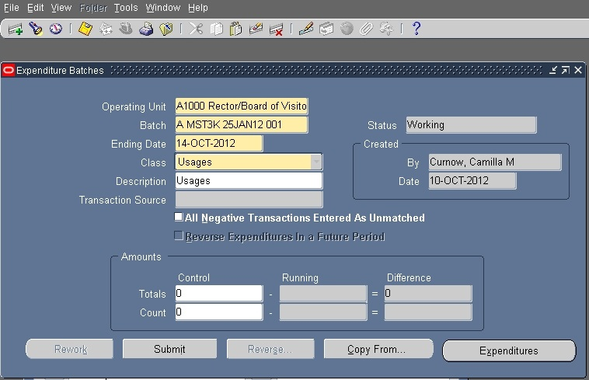
Costing Decisions & Transaction Controls
Costing Basics
Notes:
19
Transaction controls functionality was implemented on new projects effective January 3, 2005. The functionality is intended to aid compliance efforts by restricting the use of certain expenditure types on sponsored awards.
Currently there are three (3) transaction control ‘templates’ used for sponsored programs:
• Federal awards (including Federal flow-through awards) - Exclusive Control
• Training Grants and Fellowships – Exclusive Control
• Subcontracts – Inclusive Control

Slide 20
Costing Decisions & Transaction Controls
Costing Basics
This system functionality is intended to aid compliance efforts by restricting the use of certain expenditure types on specific sponsored projects.
Transaction controls are established at the PROJECT level.
Transaction controls are routinely updated given new expenditure types and costing concerns.
Can be “Exclusive” (what you seen in Oracle is what is EXCLUDED from charging) or “Inclusive” (what you see in Oracle is the ONLY thing you can charge)
Notes:
20
Transaction controls functionality was implemented on new projects effective January 3, 2005. The functionality is intended to aid compliance efforts by restricting the use of certain expenditure types on sponsored awards.
Currently there are three (3) transaction control ‘templates’ used for sponsored programs:
• Federal awards (including Federal flow-through awards) - Exclusive Control
• Training Grants and Fellowships – Exclusive Control
• Subcontracts – Inclusive Control

Slide 21
Transaction Controls-What They Are, What They Are Not
Costing Basics
They Are:
In place to assist with institutional costing consistency and our decisions
Enabled or ‘locked’ to restrict specific expenditure types from charging to sponsored projects. These select expenditure types carry risks with allowability as direct costs and/or carry risk in their allocation.
Established at the project level at the time of PTAO set-up as determined by the type of funding received.

Slide 22
Transaction Controls-What They Are, What They Are Not
Costing Basics
They Are Not:
The only determinate in considering costing decisions.
Just because a transaction control is “unlocked” doesn’t mean a particular item can be charged to that expenditure type!
All costs – regardless of whether transaction controlled or not – need careful decision making before allocating them to a project!

Slide 23
Costing Basics
Management of A Sponsored Project
Transaction Controls
The following transaction control ‘templates’ are in use:
Federal Grants, Contracts, Cooperative Agreements, Clinical Trials (including Federal flow-through awards) – Exclusive Control
Federal Training Grants and Fellowships – Exclusive Control
Subcontracts – Inclusive Control
Non-Federal Awards – Exclusive Control
Patient Care Projects – Inclusive Control
Exclusive – all expenditure types EXCEPT those listed in the template are allowable . “if you see it, you can’t charge it!”
Inclusive – ONLY the expenditure types listed in the template are allowable
“if you see it, you can ONLY charge it”
Notes:
23
"Transaction Controls" control the type of expenditures that either may or may not be allowable to a given project. Transaction Controls may be set at the project or task level. UVA is currently only defining transaction controls at the project level.
There are two methods of establishing transaction controls: Exclusive and Inclusive.
Exclusive: items that are determined to be unallowable are listed.
Inclusive: only items that are determined to be allowable are listed.

Slide 24
Costing Decisions & Transaction Controls
Costing Basics
HOW DO I KNOW IF I HAVE TRANSACTION CONTROLS?
Notes:
24
Transaction controls functionality was implemented on new projects effective January 3, 2005. The functionality is intended to aid compliance efforts by restricting the use of certain expenditure types on sponsored awards.
Currently there are three (3) transaction control ‘templates’ used for sponsored programs:
• Federal awards (including Federal flow-through awards) - Exclusive Control
• Training Grants and Fellowships – Exclusive Control
• Subcontracts – Inclusive Control

Slide 25

Costing Basics
UNLOCKING TRANSACTION CONTROLS
In order to lift or “Unlock” a Transaction Control a supporting Federal Costing Exception Request form must be submitted and approved.
This form provides a justification for costing exceptions and differences by specific project (PTAO).

Slide 26
Costing Basics
UNLOCKING TRANSACTION CONTROLS
WHEN & HOW DO I SUBMIT THE FCE FORM?
WHEN
..an award is made
..you realize you need to purchase an FCE item not previously budgeted
Review the OSP NOA and project budget for Costing Exception items – INCLUDING THOSE THAT ARE NOT TRANSACTION CONTROLLED
Complete the Federal Costing Exception Form l
Obtain all signatures
Submit to ospnoa@virginia.edu
HOW

Slide 27
Costing Basics
UNLOCKING TRANSACTION CONTROLS
Caution:
Just because an expenditure type is unlocked, doesn’t mean FCE forms are not required for subsequent purchases!
We do not “re-lock” every expenditure type after FCE-approved purchases made
Example – A department submits a FCER form for 8 desktop computers that is approved. Later on, they realize they need 2 ADDITIONAL computers. A FCER form is required for these additional purchases, EVEN THOUGH the expenditure type is already open.
For items that do not have individually identifiable unit costs, such as Office Supplies, look at the overall comprehensiveness of the charges.
Example – A department gets a FCE form approved for $5,000 in office supplies required to compile training binders for educators out in the public schools. After the project begins, a determination is made that additional content needs to be added to the binders and there will be an additional $3,000 in office supplies required. A FCE form would be needed.
Notes:
Can mention replacement items here, minimal changes in amount, focus that it is an ESTIMATE.

Slide 28
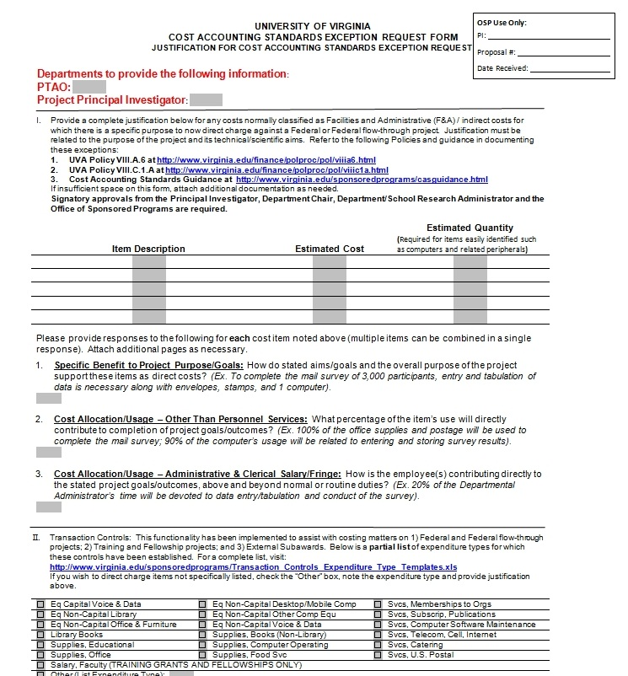
Costing Basics
http://www.virginia.edu/sponsoredprograms/compliance/costaccounting.html
Notes:
KEY POINT: ONLY 1 criteria has to be met for the award/costs to be subject to CAS regulations/practices!
covered project - (Only the individual cost(s) being used as cost sharing would be subject to CAS Example: Clerical/Admin. travel costs claimed as cost share to an NIH project
Federal awards – have them give examples of these Sponsors including Federal Sponsors
Federal flow-Through awards – more examples (can include Industry, Foundations, State, Other Universities)
Terms and Conditions – include reference to A-21 or CAS
Funds/costs used as Cost Sharing toward a CAS subject award – give examples here (office supplies charged on a non-CAS covered award; clerical/administrative salaries or travel related to these personnel; memberships/subscriptions paid from non-CAS funding; etc.)
So what happens with the remaining % of awards that are not subject to CAS? THE ALTERNATE COSTING POLICY at UVa.:
Costs applied to these awards are still subject to the terms and conditions of the sponsor, University and State procurement practices. Some of these awards while not subject to Federal and CAS guidance still have audit clauses present or financial reporting requirements and can be reviewed for unallowable costs in the eyes of the sponsor. It is true that there is more flexibility with these funds but an audit still could occur. Be diligent in the application of costs. Awards noted by OSP as having residual funds also provide more flexibility in the application of costs, especially once any financial reporting has been performed to the Sponsor by OSP accountants.

Slide 29
The “Sticky Six”:
Costing Basics
These are six cost items that are not normally allowable as a direct costs on federal/federal flow-through projects
Clerical/
Administrative Salaries
Office Supplies
Postage
Professional Memberships/
Subscriptions
Communication Costs (including cell phones, pagers, etc.)
Computers, general use software, and related charges
(These are just examples of the many items that are normally considered F&A charges.
Visit the Costing guidance web page for more information)
Notes:
29
Clerical/Administrative Salaries/Wages/Fringes
Postage (not freight)
Office Supplies
Communication Costs (recurring telephone line costs, local calls, local faxes, cells and pagers)
Professional Memberships to Organizations (Individual and sometimes Departmental)…never any social or civic memberships. Subscriptions and publications are often not able to meet the definition of a direct cost and are most often considered as F&A costs. This is not the same as publication charges and printing costs.

Slide 30
Computers, peripherals and computer-related items
Non-sponsored allocation typically required
When is 100% allocation appropriate?
Allocating Mobile units (e.g., laptops. ipads)
Allocation of peripherals (monitor, keyboard, etc)
Printers, etc.
Documenting quantities
Costing Basics
Non-sponsored allocation typically required
Allocation of mobile units (e.g., laptops,
I -pads)
What about printers, etc.?
When is 100% allocation appropriate?
What about peripherals (monitor, keyboard, etc.)?
Documenting quantities is critical.
Generally, you will need to split the allocation with non-sponsored funds to cover possible general use (email, personal use, student use, presence of any general use software, proposal writing, etc).
100% allocation to federally sponsored project(s) may be appropriate if a computer is required to run a piece of equipment, processing data 24/7, etc. Example: department is purchasing CPU (no monitor) for computer to run equipment in a lab.
Mobile units are especially risky - vast majority of circumstances will require less than 100% allocation to the project.
Allocation of approved peripherals (e.g., monitors, keyboards, etc.) should follow the percentage allocation of the approved computer they are tied to.
Printers, cables, memory sticks and the like are RARELY approved for direct charging.
Total purchased quantities throughout the life of the project should equal the number requested on FCER form(s). Any time you purchase more units than were previously approved, a new FCER form will be needed
2CFR200.453(c) In the specific case of computing devices, charging as direct costs is allowable for devices that are essential and allocable, but not solely dedicated, to the performance of a Federal award.
Notes:
Good Idea when deciding on the application of costs directly to an award: The prudent person test – Would your Mother approve of your doing this? Would Judge Judy be OK with your decision?
Place yourself on a jury or be the judge – Can you argue for your decision or in applying the guidance given would you have a hard time with your decision?
We will explore this in discussing ‘Unlike Circumstances”.

Slide 31
Costing Basics
Software
Software is NOT transaction controlled, but may still need FCER form, depending on the kind of software you are charging:
Software Type | Examples | Transaction Controlled | CAS form needed?
General Purpose | Microsoft Office Adobe Illustrator, Acrobat, etc. End Note Snag-It Others | No | YES – general purpose software is considered part of F&A (overhead) and requires justification for direct charging
Technical Software | Software required to run technical equipment Specialized software that is clearly technical in nature (for example, mouse colony management software) | No | No

Slide 32
General Office Supplies
Sharpies /pens
Staples
Sticky notes
Paper *
Toner cartridges*
Printer ink *
Binders
Many more!
Costing Basics
They are transaction- controlled (FCER required to unlock “Supplies, Office”)
To allow direct charging, must demonstrate unusual circumstance & be a large amount relative to regular use (see unlike circumstances/major projects)
Paper, toner cartridges and printer ink are unlikely to receive FCER approval for direct charging.
sharpies
staples
sticky notes
paper
toner cartridges
printer ink
binders
Many more!
Notes:
Good Idea when deciding on the application of costs directly to an award: The prudent person test – Would your Mother approve of your doing this? Would Judge Judy be OK with your decision?
Place yourself on a jury or be the judge – Can you argue for your decision or in applying the guidance given would you have a hard time with your decision?
We will explore this in discussing ‘Unlike Circumstances”.

Slide 33
Key Terms/Concepts: Expressly Unallowable Costs
Costing Basics
Costs which cannot be proven to be necessary, reasonable, allocable and thus, the federal government will not cover/reimburse, either as a direct or as an F&A cost.
Alcoholic
beverages
Entertain-ment
(lab gatherings, non-technical meetings)
Fines/penal-ties/fees (late payments to vendors)
lobbying
losses on other sponsored projects
memberships in civic, community organizations and country clubs
public relations
Notes:
33
The next few slides will provide key definitions of costs: OSP really doesn’t make this stuff up!
KEY POINT: When we speak of unallowable costs we are talking about those costs that are expressly unallowable as defined by A-21 or in specific sponsor terms and conditions award by award.
This is mostly common sense and what does the sponsor/tax payer really want their funding to be used for?
Real life examples of costs seen as direct charges: PI watch damaged in the lab while testing; office Christmas tree; flowers for the PI due to a death in the family.
Don’t get this definition confused with costs that unallowable as DIRECT charges. See if they can give some examples…..(clerical/administrative salaries; office supplies; postage; local recurring telecommunication costs; cell charges/pagers; general computer usage; memberships/subscriptions/library books) These costs are allowable…just not normally through a DIRECT charge and are recovered HOW? (see if they know)…..via F&A rates.

Slide 34

Why Is Selecting the Right Expenditure Type So Important?
Costing Basics
Budgets were formulated based on specific types of costs
Budgets were approved for those specific costs
Financial reporting often requires detailed cost breakdowns
Reduces audit findings
If it’s a duck – call it a duck!
Notes:
Common errors – over use of the Other expenditure types; placing general/office supplies in lab supplies; equipment versus supplies; subscriptions and publications versus publication costs and page printing charges, etc.

Slide 35

More On Facilities & Administrative Costs (F&A)
Costing Basics
These costs are:
  not charged directly to Federal or Federal flow-through sponsored awards – cannot meet the direct cost definition
  not a ‘tax’ assessed to sponsored research awards
  based on real expenditures previously incurred across grounds in support of research activities
  represent partial recovery of costs already incurred by the University
The recoveries of F&A costs are distributed based on a formula established and reviewed by the Academic Vice Presidents
Notes:
35
These costs cannot be tied specifically to one award and benefit many different objectives at the same time.
Ask for examples from the audience.

Slide 36
What is the F&A Cost Rate?
A single number that reimburses the institution for the use of:
  Buildings
  Equipment
  Interest on Debt
  O&M
  General Administration
  Departmental Administration
  Sponsored Projects Administration
  Library
F&A Slides Courtesy Caroline Beeman
UVA Cost Analysis
Notes:
We will go over these in detail.
O&M stands for Operations and Maintenance.

Slide 37
…or stated another way…
The ratio, expressed as a percentage, of an OR facilities and administrative cost pool and an OR direct cost base.
The OR cost pool is made up of allocations from the administrative and facilities cost pools
OR pool costs / OR base direct costs = OR F&A rate.
(OR=Organized Research)

Slide 38
Calculation of the Facilities & Administrative Cost Rate
(aka = Indirect Cost Rate)
F&A COSTS
Building Depreciation
Equipment Depreciation
Interest on Debt
Operations & Maintenance
Library Support
General Administration
Departmental Administration
Sponsored Project Administration
DIRECT COSTS
Research Salaries & Fringes
Consultant Services
Travel
Technical Services
Research Supplies
Subcontracts up to $25,000
Committed Cost Sharing
$88,160,000
F&A Costs ÷ Direct Costs
$152,000,000
0.58 = 58%
F&A Slides Courtesy UVA Cost Analysis
Notes:
You can see the same F&A costs listed two slides back on the left. The F are blue and the A are orange.
On the right are some of the types of costs that go into the base.
We divide the costs associated with research by the research base to get the F&A rate. The fraction, that’s expressed as a percent.
Click to show the numbers. These are approximately what we ended up with after our last negotiation

Slide 39
The F&A Rate Calculation Process
Audited Financial Statements
MTDC Exclusions:
Capital Expenses
Subcontracts >$25k
Scholarships/Fellowships
Patient Care Costs
Tuition Expenses
Rental Costs
Other Exclusions:
Cost of Goods Sold
Total Costs
Adjustments & transfers
F&A Costs Pools:
Depreciation
Operations & Maintenance
General Administration
Departmental Administration
Sponsored Program Admin.
Library
Student Admin. & Services
Review for Unallowable Expenses
Applicable Credits
Direct Cost Bases:
Instruction and Dept. Research
Organized Research
Other Sponsored Activities
Other Institutional Activities
Other Special Direct Bases
Assign Expenses to F&A Pools and Direct Bases
Allocations
F&A Costs | Major Functions | Distribution Base
X | Instruction & Department Research | XX
X | Organizes Research | XX
X | Other Sponsored Activities | XX
X | Other Institutional Activities | XX
F&A Slides Courtesy UVA Cost Analysis

Slide 40
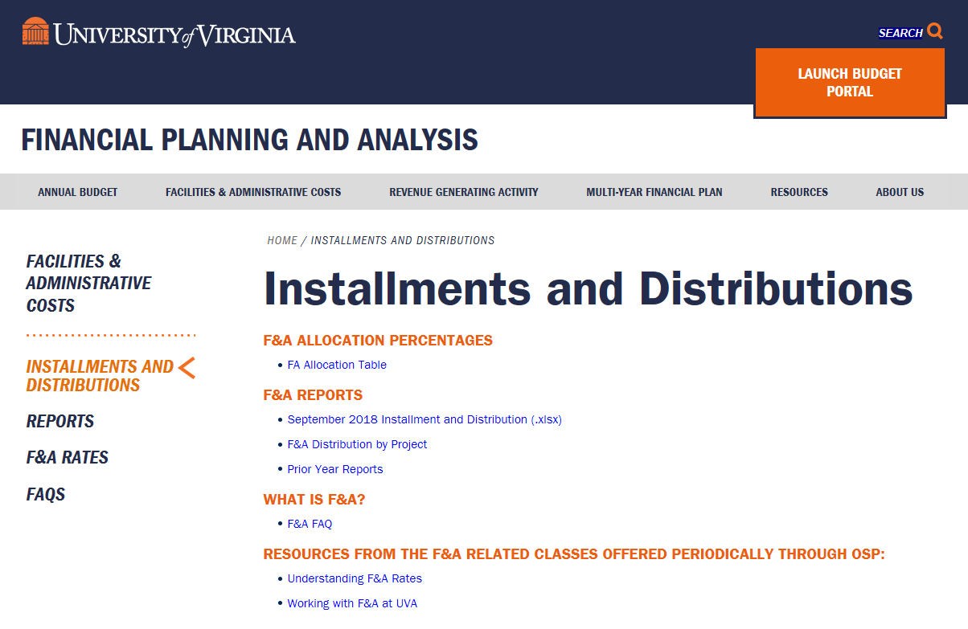
UVA Financial Planning And Analysis
https://financialplanning.vpfinance.virginia.edu/installments-and-distributions
Notes:
This is the F&A web page. You can get to it by typing F&A Distribution into the Search Uva block that’s at virginia.edu home page, be sure to select the “Web” button. ALT + TAB
F&A Allocation link: There are instructions on how to make this add up to 100%.
Remember these percents are percent of the F&A that goes to various departments, whereas 58% is the percent that is multiplied times MTDC to figure out how much F&A is being charged to the grant. Two different percents of two different things.
By Projects Rpt: Let’s look at the same grant. Let’s go to Feb-10, then the Dept Curr Month Tab and use the filter to get Org 31695, Chem. Then to GQ10044, then to project 133946.
You can see the $6,789.81 in F&A. On the Dept tab you can see how I multiplied that times the percentage that Chemistry gets to calculate the department’s share of F&A.
There is also a tab for the Deans and there are tabs for just year-to-date if you don’t want just current month numbers.
Installment & Distr Rpt: This report will show how much F&A was brought into the University by all the grants in your department.
There are five tabs in this report.
1- Recoveries shows the recoveries by month for each department. Departments with more than one Org number are grouped together, but you can see the detail by expanding the subtotal level. This report could be useful if your chair wanted to demonstrate how much F&A revenue his department was contributing to the University.
2-Dept Dist shows the distribution to each department. This is useful for you to see how much your department should have in F&A recoveries in your FA award installment.
3-Deans Dist shows the distribution to each Dean by how much each of their departments contributed.
4-The Dist tab shows how much F&A by month each office (I called it Target) got.
Remember the “F&A Distribution – Percentage Allocations” chart? The one that shows how the F&A is split up once it gets to the University. This is the dollars that goes with those percents.
What is Other? Other is the third school piece for SEAS for O&M on their newest building. They are the only school that has a third split within the school.
Warning: you cannot merely take the “State Total” dollars and divide by the bottom sum to figure out the percentage allocation. There are some orgs that have a different percentage going to this distribution target than other orgs. For instance, remember that UVA Wise was 30% state, 20% governor and 50% school. State is 27.8% for most others.
5-Install, the fifth tab, shows the amount on the current year installment as of the end of the previous month.
Show the FAQ link.

Slide 41


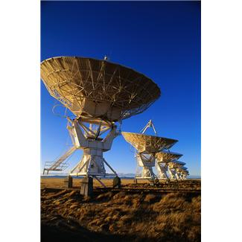


Direct Charging of Items That Are Normally Considered F&A
When Circumstances are Not ‘Like’
Costing Basics
Notes:
41

Slide 42

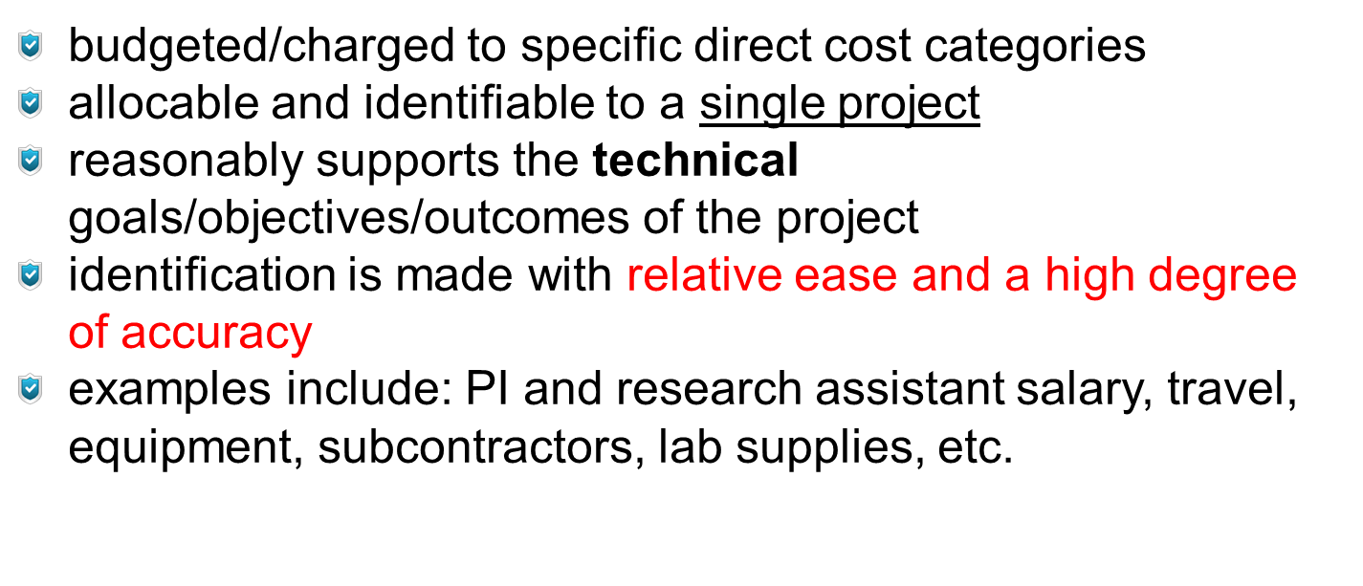
CAS ‘Unlike Circumstances’ – Position that an F&A Cost Will Be Charged Directly
Costing Basics
Remember this?
  Must satisfy the definition of a DIRECT COST:
    KEY: allocable and identifiable with relative ease & high degree of accuracy
    For clerical/admin salaries – work should typically be ‘extensive’ in nature (over and above routine support by the academic unit)
    Align with the funded purpose of the award to ensure that its goals are unlike those generally charged as F&A costs

Slide 43

Adequacy in the Justification of ‘Unlike Circumstances’
Costing Basics
Always include the following information on the FCER Form:
specific cost item(s)
comprehensive justification, addressing extensiveness and PURPOSE
estimated item quantity and unit cost
Project/Task/Award information
Principal Investigator’s last name
Notes:
Justification should be clearly related to the proposal, tasks outlined to the Sponsor. Detailed and quantifiable information related to the “unlike circumstance” is necessary.
The following phrases add no value to written justifications: “Needed for the research project”, “Costs have been approved by the Sponsor”, “Costs have been allowed as direct costs in the past.”

Slide 44

Direct Charging of Items That Are Normally Considered F&A
When Circumstances are Not ‘Like’
Costing Basics
Clerical/Administrative Salaries
2CFR200.413
Four conditions under which direct charging of such salaries are allowable:
Administrative or clerical services are integral to a project/activity
Individuals involved can be specifically identified with the project/activity
The costs are explicitly included in the budget or have prior written approval of the federal agency
The costs are not also recovered as indirect cost
Notes:
44

Slide 45

Costing Basics
ADMINISTRATIVE – CLERICAL STAFF SALARIES:
EXHIBIT C #1
Large, complex programs -
Includes General Clinical Research and Primate Centers, Program Projects, environmental and engineering research centers and other grants and contracts that entail assembling and managing teams of investigators from other organizations

Slide 46

Costing Basics
ADMINISTRATIVE – CLERICAL STAFF SALARIES:
EXHIBIT C #2
  Projects that are geographically inaccessible to routine support, i.e., research vessels, radio astronomy projects, other remote field locations

Slide 47

Costing Basics
ADMINISTRATIVE – CLERICAL STAFF SALARIES:
EXHIBIT C #3
Projects that require a large number of repeated travel and/ or meeting arrangements for large
numbers of participants, such as conferences and seminars

Slide 48

Costing Basics
ADMINISTRATIVE – CLERICAL STAFF SALARIES:
EXHIBIT C #4
Projects involving
extensive data accumulation, analysis and entry, surveying, tabulation, and cataloging

Slide 49

Costing Basics
ADMINISTRATIVE – CLERICAL STAFF SALARIES:
EXHIBIT C #5
Projects funded to produce large numbers of reports, manuals, books, and monographs (excluding routine progress and technical reporting)

Slide 50
Insufficient F&A cost recovery funds to support cost
Sponsor won’t pay F&A costs
We are the sub and the prime allowed it (e.g. State projects)
Sponsor approval of the budget. Sponsors do NOT review for CAS – this is an institutional responsibility.
Technical officer approved it. – They do not have the authority to exempt us from CAS
Costing Basics
Invalid Arguments For Direct Charging F&A COSTS
Insufficient F&A cost recovery funds to support cost
Sponsor won’t pay F&A costs
We are the sub and the prime allowed it (e.g. State projects)
“But the sponsor approved it”
Sponsor is willing to pay questioned costs as direct
We did it that way before!
Notes:
50
These are called……I understand your pain, but DON’T GO THERE!

Slide 51


Costing Basics
Funding Issues
“How do I pay for this??”
~should not be confused with~
Costing Issues
“Does this charge meet criteria for direct charging to the project?”
Notes:
51
State that there is a difference. Needing the money does not mean it can necessarily be direct charged.

Slide 52
What is Cost Sharing?
Cost Sharing represents the sponsored project costs (direct and indirect) that would normally be borne by the sponsor, but instead are covered by the institution or a third party, such as a subcontractor
Types of cost sharing
      Mandatory-Required by the sponsor & an award condition included in the solicitation; a binding commitment
      Voluntary Committed-Not required by the sponsor, but PI offers quantifiable institutional resources in the proposal; when awarded, becomes a binding commitment
      Voluntary Uncommitted - Institution supports research costs, which are not included or quantified in the proposal; when awarded, does not become a binding commitment
      Over-the-cap commitments (e.g., NIH salary cap)-statutory requirements

Slide 53
Award with Cost Sharing – Now What?
Cost sharing commitment entered in Oracle, with appropriate cost share code
Cost share codes used at UVA:
        0-Salary/effort; 2- No cost sharing; 3-OTPS; 4-OTPS and Salary; 5-MTDC exclusions; 6-Waived indirect costs; 7-Third party external; 8-External sub; 9-External sub and UVA
Cost sharing funding source/s re-confirmed at the Award acceptance stage
Important to remember that, cost shared expenditure are…
      Subject to federal cost principles
      Subject to audit
      Easily identifiable for F&A rate proposal
      Part of the official record (record retention)

Slide 54
Cost Sharing Funding Source-Cash
Cash
Institution funds
Gift
Non-federal Grant
Program income, waived F&A

Slide 55
Cost Sharing Funding Source-Non Cash
Unfunded effort of key personnel –from collaborators
Donated property, certification for the value of donation
Sub-awardee cost sharing

Slide 56
Cost Sharing Funding Source-Non Cash
Sub-awardee cost sharing
request sub-awardee to submit periodic cost sharing reports
Sub-awardee invoices should reflect inception to date cost shared amounts
Donated property
Document value of the donation
Unfunded collaborators
request cost share certified quantifying amounts

Slide 57
Impact of Cost Sharing on Facilities & Administrative Cost Rate
No Cost Sharing
F&A COSTS
Building Depreciation
Equipment Depreciation
Interest on Debt
Operations & Maintenance
Library Support
General Administration
Departmental Administration
Sponsored Project Administration
DIRECT COSTS
Research Salaries & Fringes
Consultant Services
Travel
Technical Services
Research Supplies
Subcontracts up to $25,000
$69,540,000
F&A Costs ÷ Direct Costs
$114,000,000
0.61 = 61%
Notes:
The “F” (Facilities costs) are blue and the “A” (Administrative) are orange. F&A is also known as indirect or overhead costs.
The column on the right contains some of the types of costs (direct spending on grants) that go into the research base.
We divide the costs associated with research by the research base to get the F&A rate which is a fraction that’s expressed as a percent.

Slide 58
Impact of Cost Sharing on Facilities & Administrative Cost Rate
With Cost Sharing
F&A COSTS
Building Depreciation
Equipment Depreciation
Interest on Debt
Operations & Maintenance
Library Support
General Administration
Departmental Administration
Sponsored Project Administration
DIRECT COSTS
Research Salaries & Fringes
Consultant Services
Travel
Technical Services
Research Supplies
Subcontracts up to $25,000
Cost Sharing $1.5M
$69,540,000
F&A Costs ÷ Direct Costs
$115,500,000
0.60 = 60%
Notes:
Cost shared expenses need to be included as “research costs” in the base. When the base (denominator) increases, rate goes down!

Slide 59
Cost Sharing Companion Account Structure

Slide 60
A Few Examples of Cost Share
Costing Basics
Commitments of Faculty effort not supported by the Sponsor’s award, or re-budgeting of Sponsor supported salary/effort into other costs categories
Faculty salaries above the ‘salary cap’ – imposed by the National Institutes of Health –cannot be used as cost sharing, but included in the OR base
Travel, supplies, equipment costs not supported by the Sponsor’s award
Project deficits/cost-overruns
Example: A university receives a grant for a project estimated to have a total cost of $100,000. The sponsor agrees to pay 75% ($75,000) and the university agrees to pay 25% ($25,000). The $25,000 is the committed ‘cost-share’.
Notes:
60
Reiterate the effect of cost shared dollars on our F&A recovery rate. It drives it down!
OSP will be developing a workshop on Cost Sharing Fundamentals – look for future information on this core course.
Cost Sharing can sometimes be called: Matching funds, In-Kind contributions
For now: Take care in making unnecessary commitments in proposals that require additional funds from other sources to aid in completion of the project. Don’t make promises of effort if the Sponsor will pay for salary of personnel! Once you quantify or provide hard $ or %’s of any additional funding you have committed the University to cost sharing.
When using cost shared $$ from non-CAS awards to a CAS award remember this RULE OF THUMB: If you could not have charged this cost directly to award requiring the cost share, you CANNOT use the cost as cost sharing!

Slide 61
Circumstances where a CAS form is NOT required
NON-federal projects
Non-sponsored projects
Software that is clearly technical in nature
Technical Equipment purchases (e.g., Lab Equipment)
GRA’s (Graduate Research Assistants)
Replacements of PREVIOUSLY CAS APPROVED items purchased on that exact PTAO number (be sure and document!).
When DON’T I need a CAS form?
Non-federal projects
Non-sponsored projects
Software that is clearly technical in nature. See the Software discussion for additional information
Specialized equipment purchases (e.g., microscope, autoclave).
Replacements of PREVIOUSLY FCE APPROVED items purchased on that exact PTAO number. (it’s a good idea to be sure you have the original approved FCE form as part of your documentation for the new charges)

Slide 62
Costing Basics
How Can We Be Successful in Managing Costs ?
Federal Regulations
- Uniform Administrative Requirements, Cost Principles and Audit Requirements of Federal Grants and Cooperative Agreements, 2CFR200
- Federal Acquisition Regulations (FAR) - Contracts
UVa. Guidance
- Internal Policies and Procedures
- CAS Disclosure Statement (DS-2)
- State of VA Guidelines
Sponsor Award Terms and Conditions
- Can be unique with each award/project
- Can be more restrictive not less than CAS
Facts and circumstances of each award
- The scientific goals/outcomes relate to the types of costs that can be budgeted and charged DIRECTLY (PURPOSE).
“The science drives the charge.”
Notes:
62
PRE and POST AWARD administrators need to be versed in the Body of Knowledge. No longer can we separate the 2 mentalities of award administration. “DOING YOUR HOMEWORK” and application of CAS starts with the submission of a proposal and it’s budget not upon the first costs being posted to the account.
Mentioned on the slide are a few of the more prominent Federal regulatory documents that impact costing practices and award administration. There are certainly more regulations and laws that can apply – reference the specific award terms for this information. A-21 is the Costing circular; A-110 is the Administrative circular mentioning certain processes and systems that must be in place before receiving federal funds; FAR = Federal Acquisition Regulations are most often cited for contacts and not grants or cooperative agreements.
Internal policies and procedures are established from the interpretation of the federal regulations and applied differently institution by institution. Specifically CAS guidelines and the disclosure statement can be noted. Additionally, the OSP website can link you to all of the applicable policies and procedures related to sponsored awards.

Slide 63
What Are You Asking Us To Do?
Costing Basics
Document costing decisions
Communicate on purchases and decisions in charging those costs
Differentiate between NEED for the item and the PURPOSE of the award
Select the most proper and descriptive expenditure type for the cost incurred
Make the most accurate costing decision the first time avoiding cost transfers
The Right Thing!
Notes:
Acknowledge the important roles we are all in – accept responsibility for our decisions and seek the knowledge to help us be successful in fulfilling the research mission of the University and our Faculty.
Don’t pass the buck – to the central level offices. Have forthright discussions with your Faculty on their costing needs and remain CONSISTENT in your application.
Come back through these educational sessions as often as you like.

